Slide 1
Generic Programming Part 2:
Java How to Program, 10/e

Slide 2
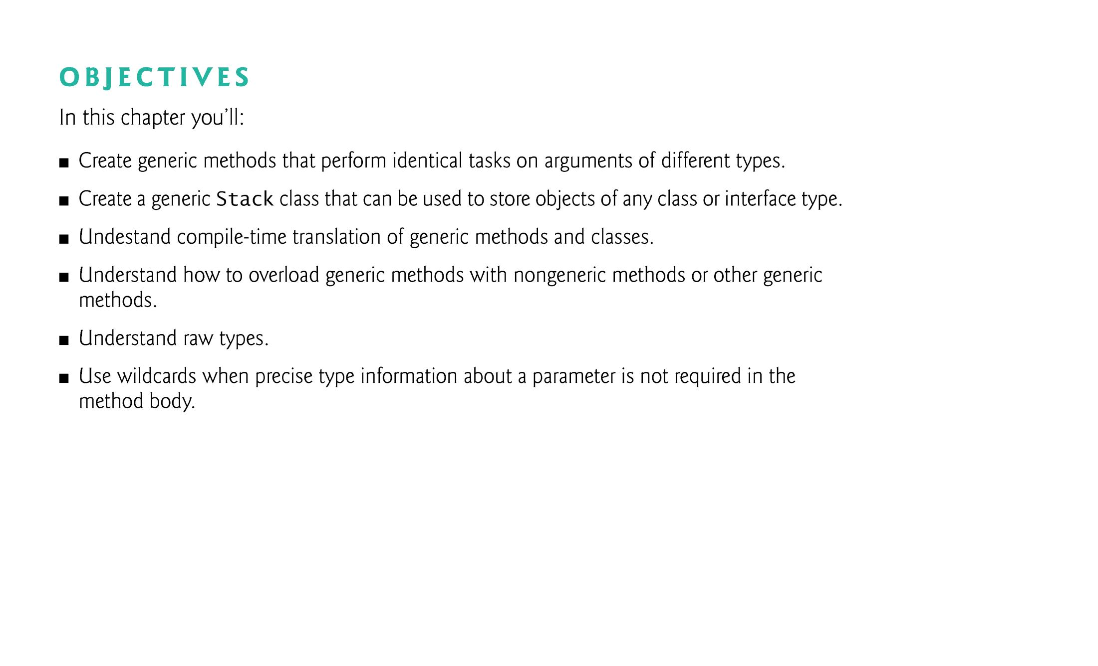

Slide 3
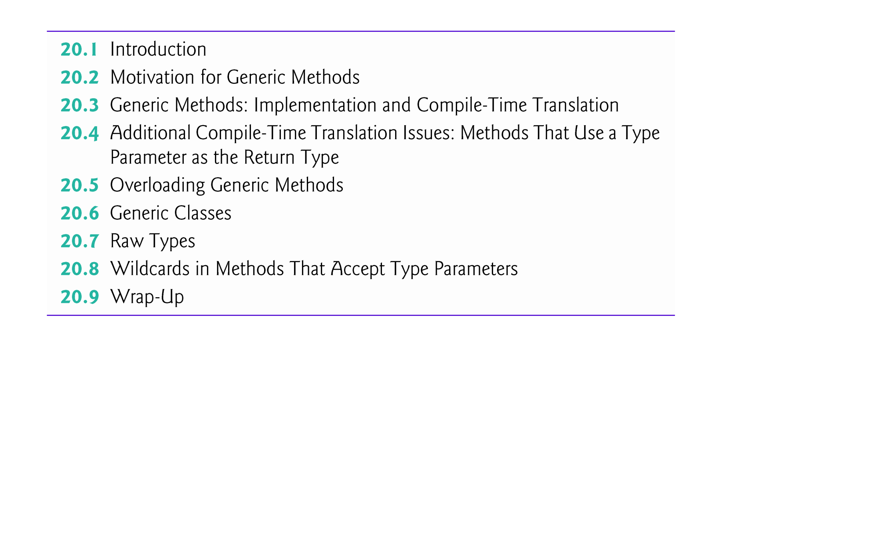

Slide 4
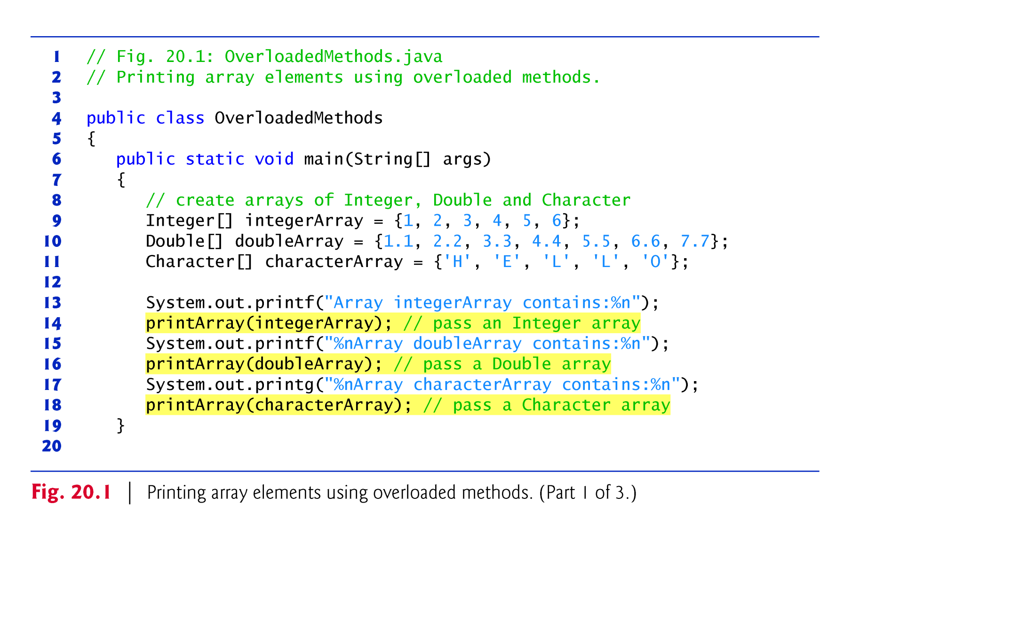
Example 1: program that illustrates the use of several overloading methods

Slide 5
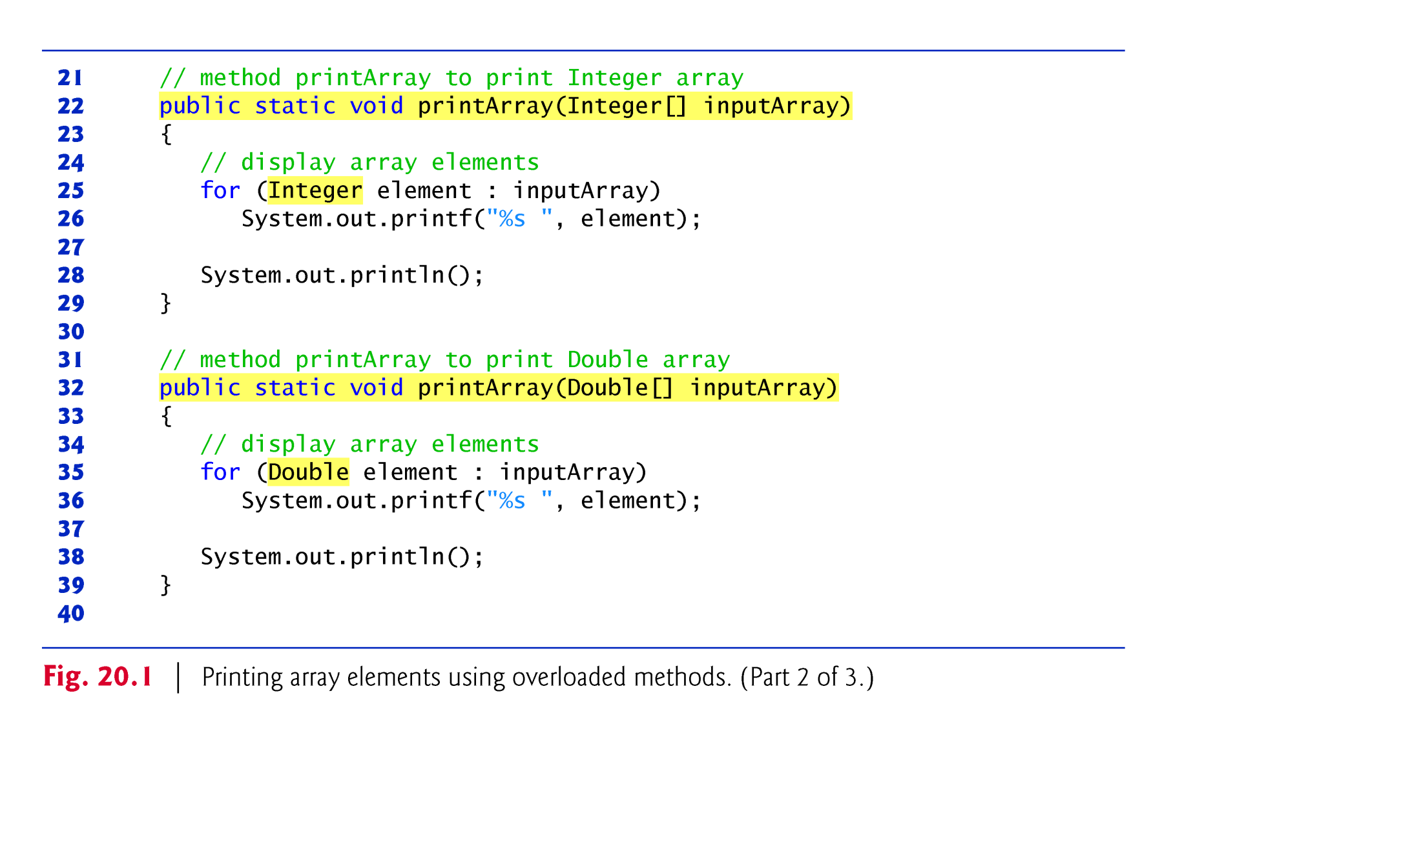
Example 1: program that illustrates the use of several Overloading
methods cont’d

Slide 6
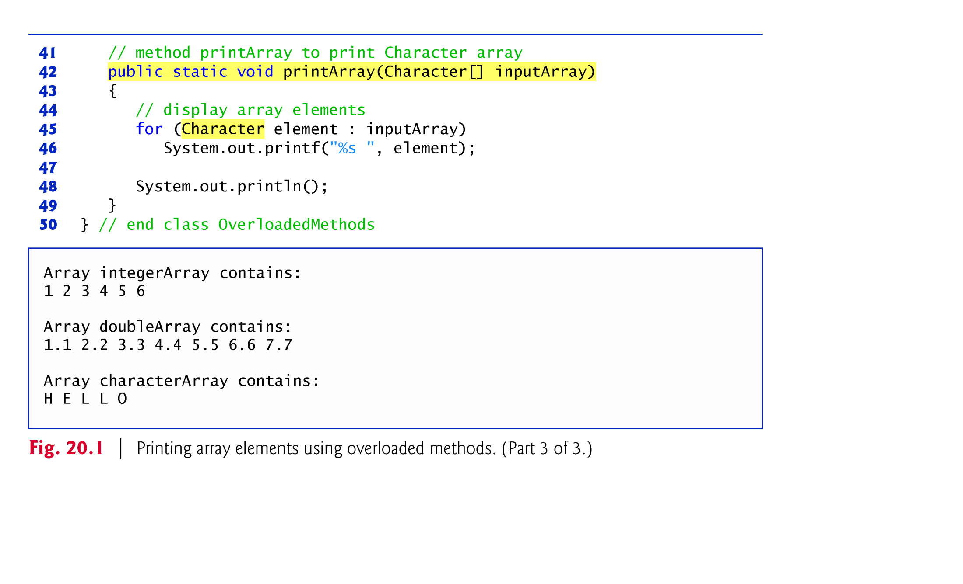
Example 1: program that illustrates the use of several Overloading
methods cont’d

Slide 7

Example 2 (A) : Modify Example 1 using one Generic Method Instead of overloaded methods

Slide 8
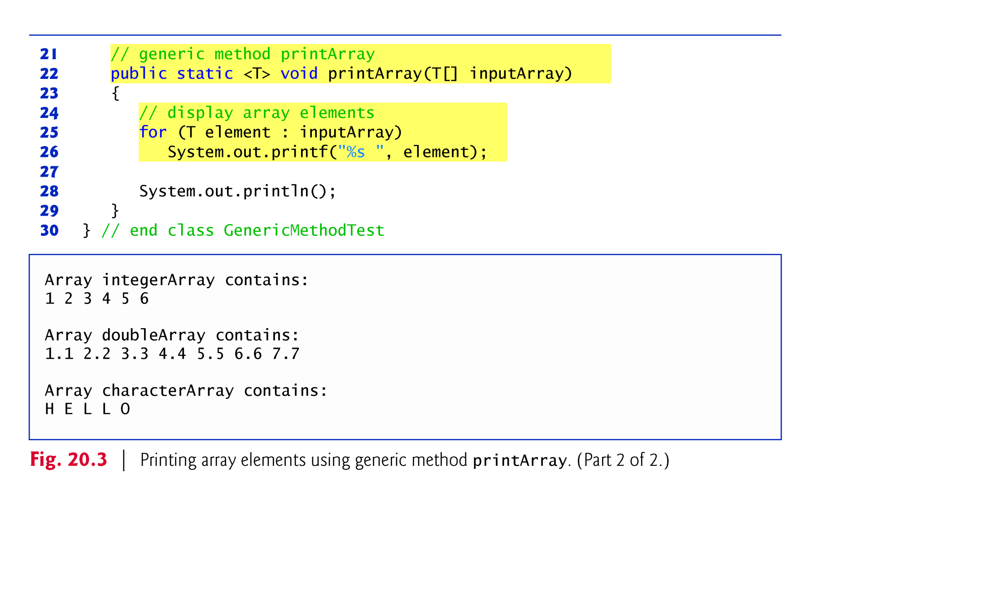
Example 2 (A) : Modify Example 1 using one Generic Method Instead of overloaded methods cont’d
The outer class is normal(non-generic, line 4),
The method is generic (Line 22)
The type-parameter has no bounded type( Line 22)

Slide 9
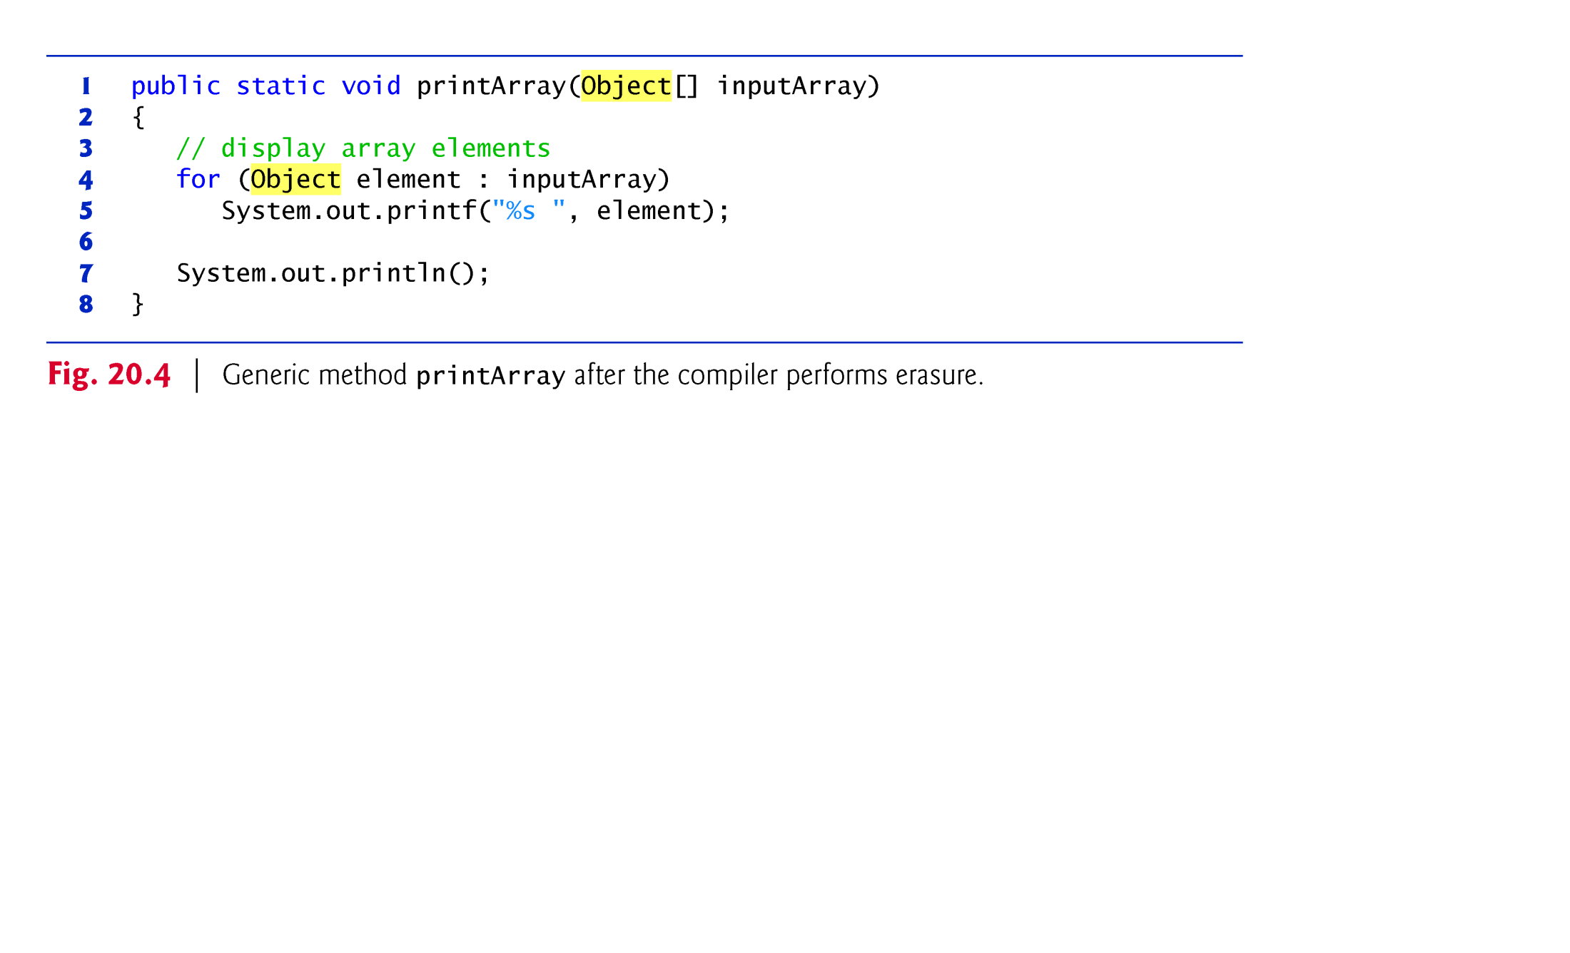
Example 2 (B) : Modification of Example 2(A) by the erasure utility of compiler
when compiler translates generic method in example 2 into java byte code,
it removes the type-parameter with its angle brackets <> from the type-parameter location
It replace type-parameter at other locations by Object type if type-parameter has no upper bound type (Line 1 and 4)
It replaces type-parameter by upper bound type if it has.

Slide 10
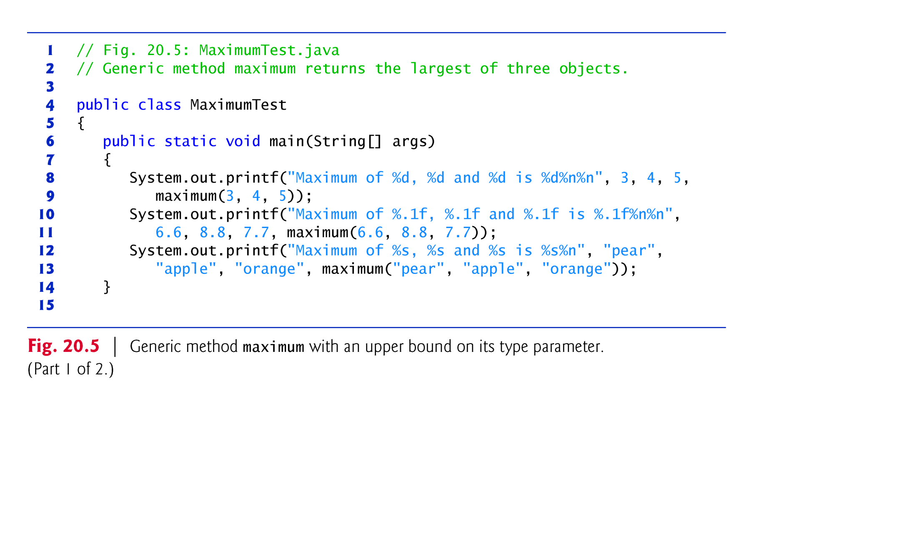
Example 3 (A) : a program that shows a generic method
when its type-parameter has bounded type: see, Example 2(A)
Line 4: The outer class is normal (non-generic),
The method is generic ( next slide, Line 17)
The type-parameter has bounded type (next slide, Line 17).
Line 8- l3: auto boxing and then auto-unboxing

Slide 11
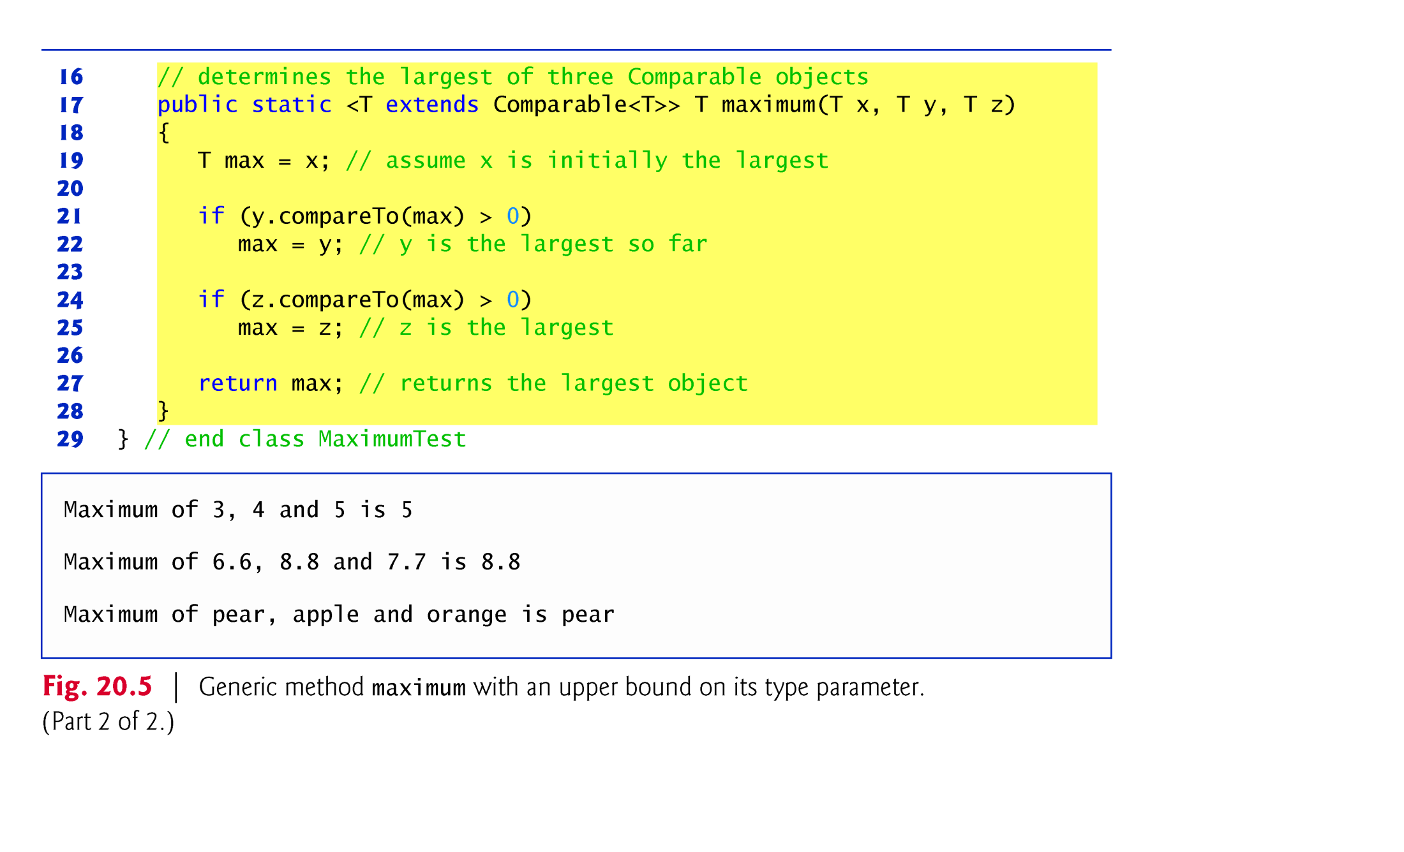
Example 3 (A) : a program that shows a generic method
when its type-parameter has bounded type: see, Example 2(A)
Line 21: Comapre<T> is called Upper bound type for type –parameter T
Hence, T is restrictive type because only such type of objects can be compared.
Line 21: comapreTo() method is valid because all wrapper classes and String class implement Comparable Interface.
e.g.Integer class implements Comparable<Integer> interface

Slide 12
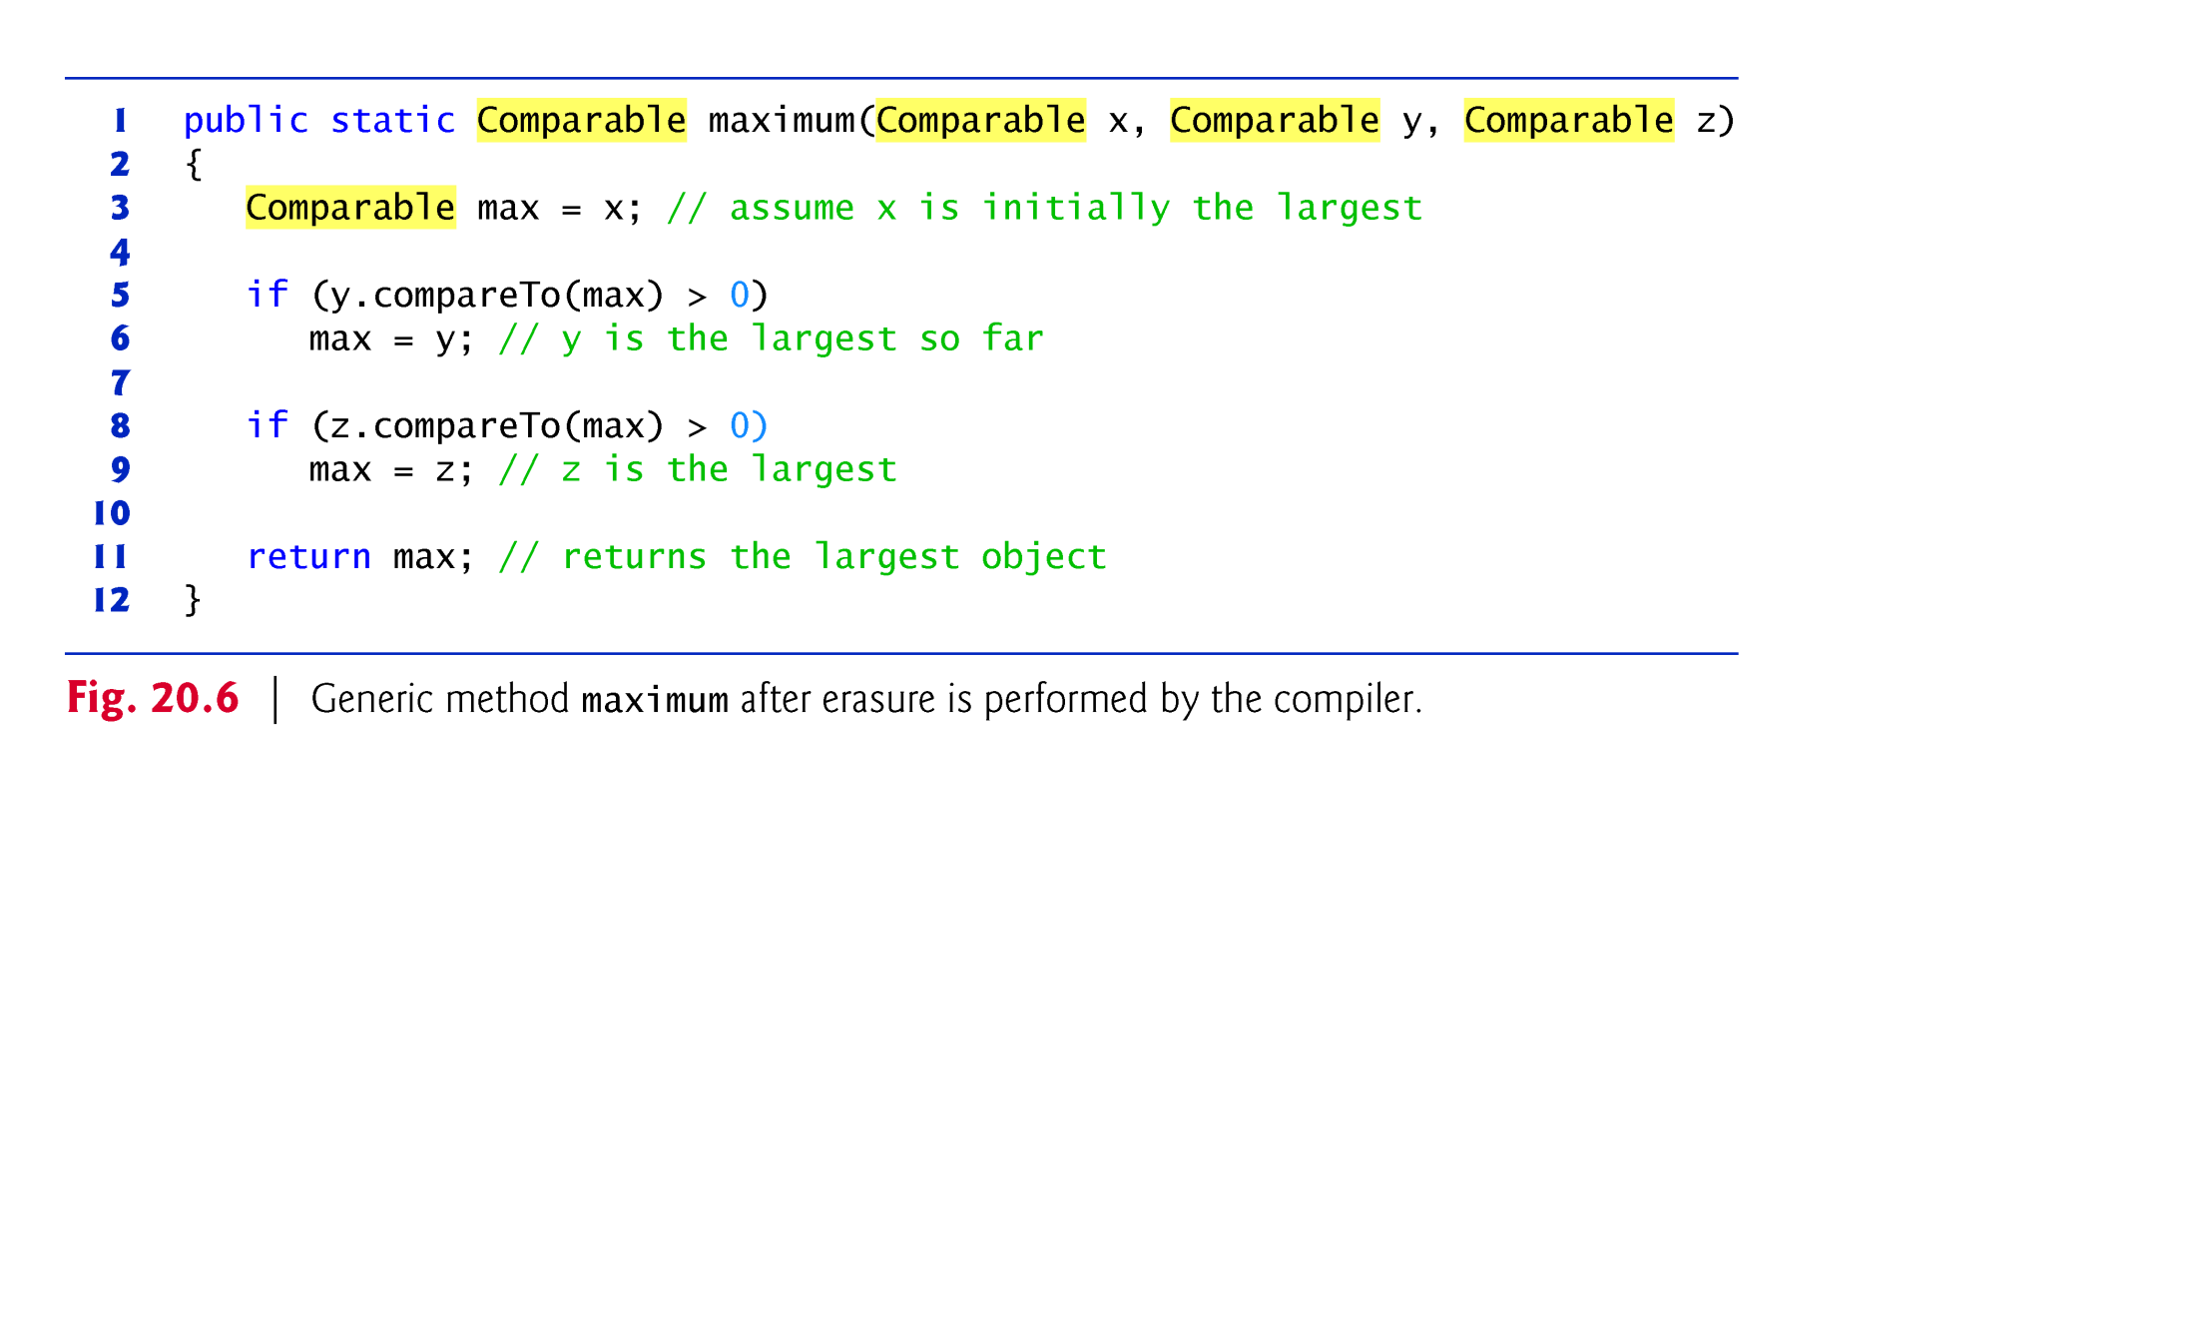
Example 3 (B) : Modify Example 3(A) by Erasure Utility of
Compiler
After erasure, the return type is Comparable. But, the caller excepts objects of type Integer, double and String respectively.
The reason is that the compiler inserts explicit cast operations in front of each method call during erasure operations as follows
Line 9, example 4: (Integer ) maximum (3,4,5 )
Line 11, example 4: (Double ) maximum (6.6, 8.8, 7.7 )
Line 13, example 4, (String ) maximum (“peaor”, “anger”, “apple”)

Slide 13
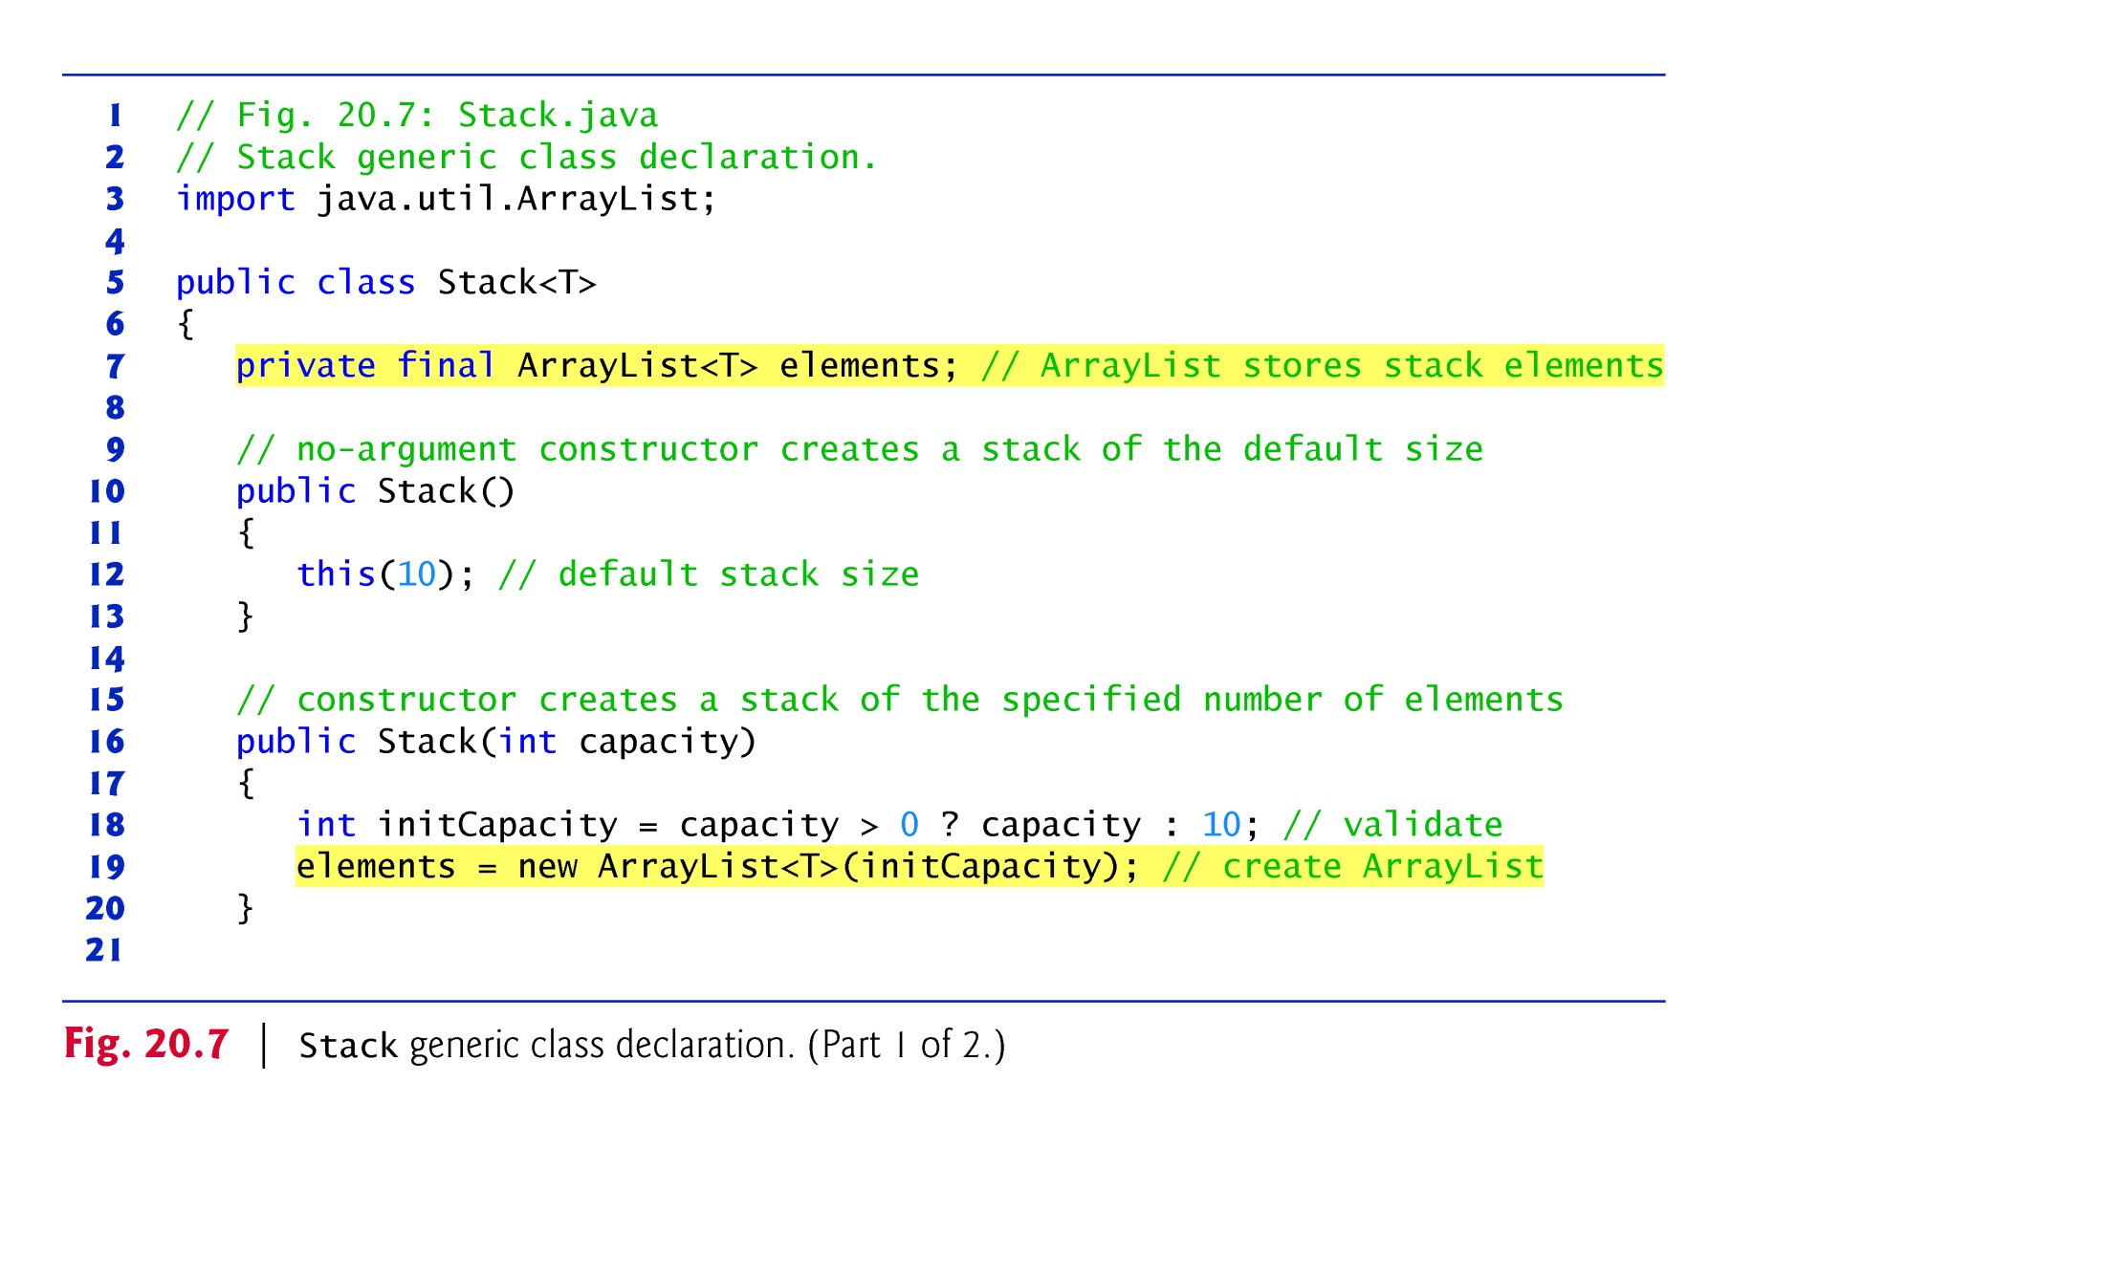
Example 4 (A): This program illustrates the implementation of stack data structure using generic class
From one generic stack class(base), we can create many logical stack classes such as Stack of Double, Stack of Integer, Stack of Student, etc

Slide 14
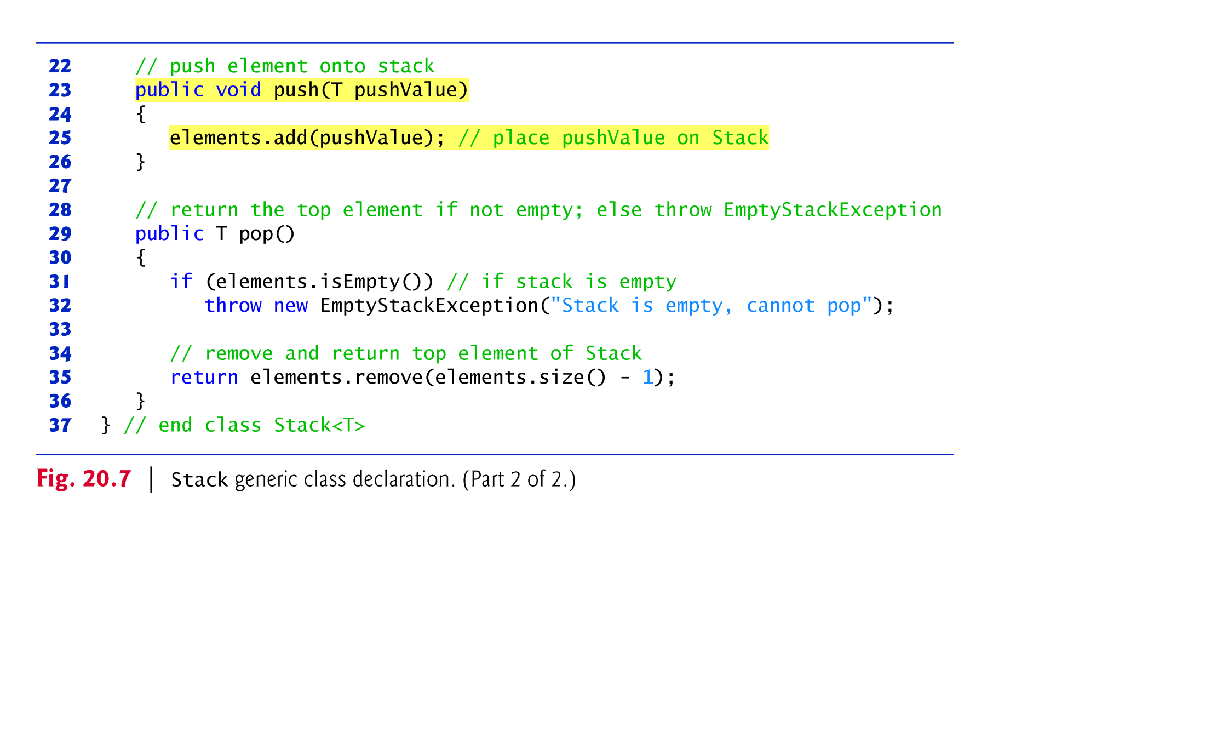
Example 4 (A): This program illustrates the implementation of stack data structure using generic class cont’d

Slide 15
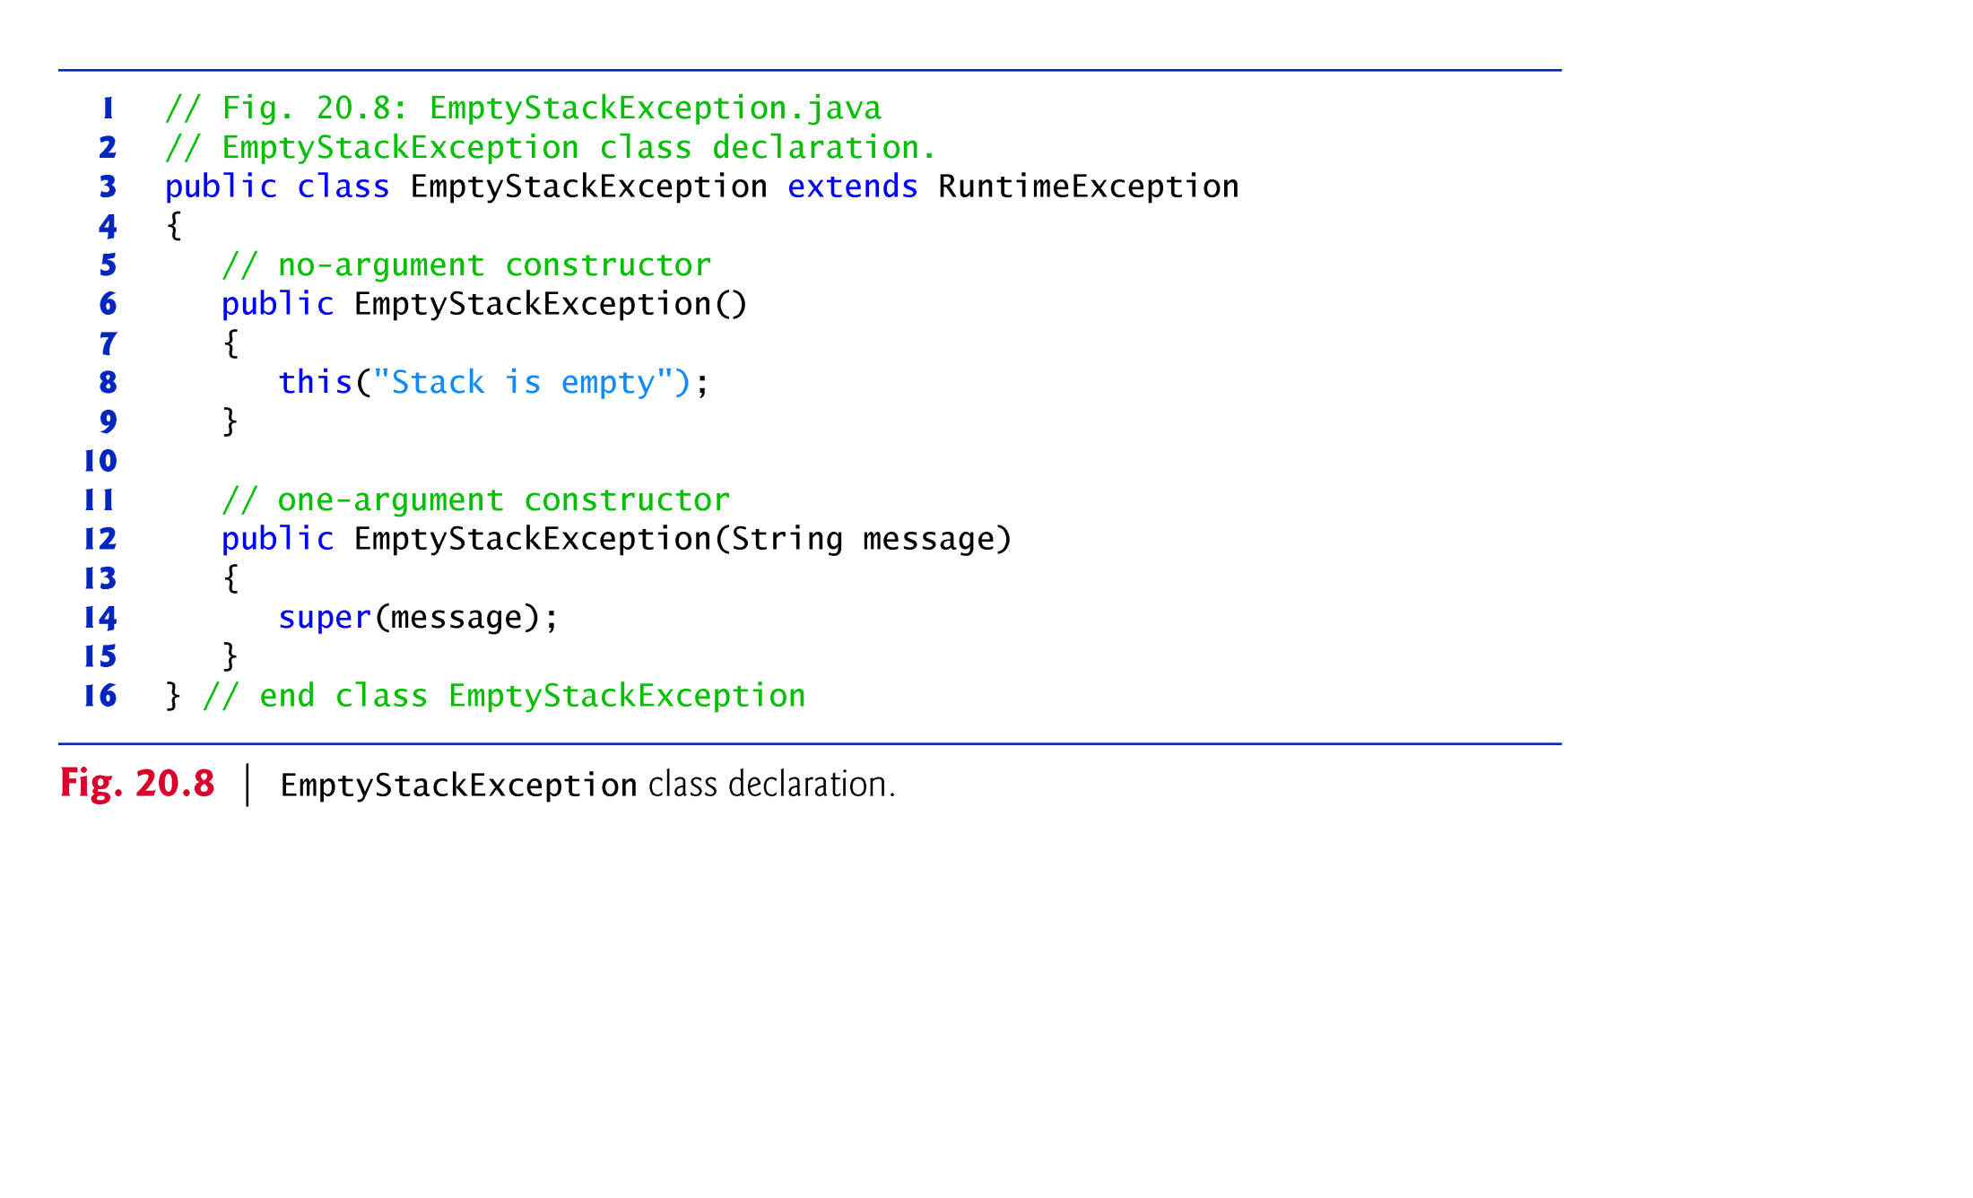
Example 4(B) : Exception handling class for Example 4(A)
In Fig 20.7, line 29, the pop() operation may try to remove from empty stack. Hence, the programmer defined his own exception handling class

Slide 16
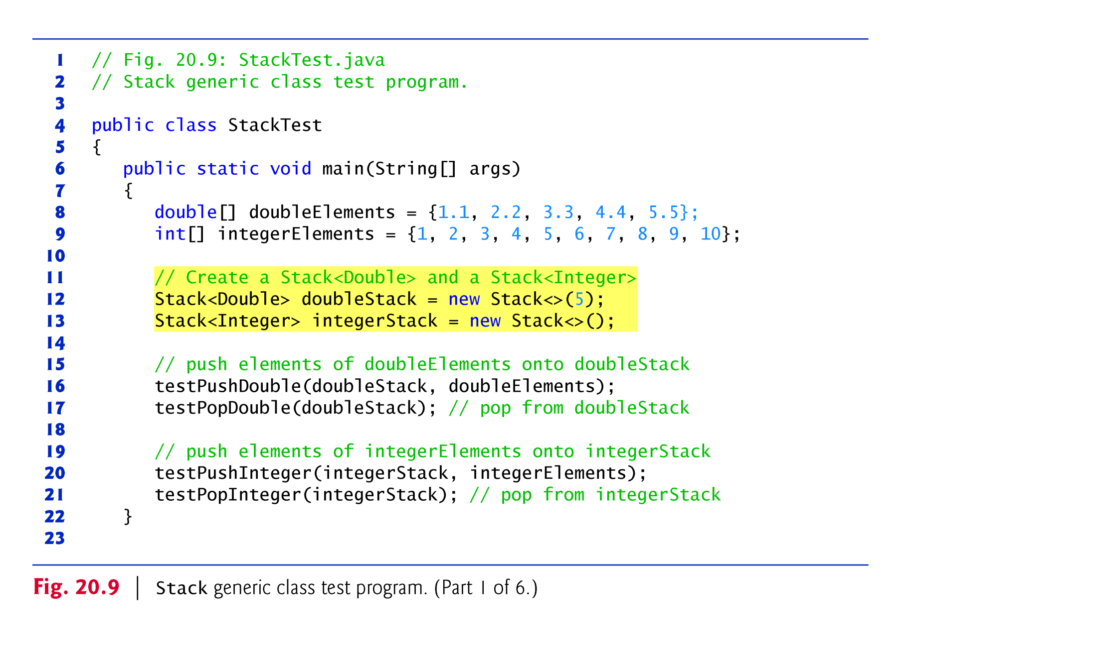
Example 4(C): This program tests the generic stack class in Example 4(A) using non-generic method

Slide 17
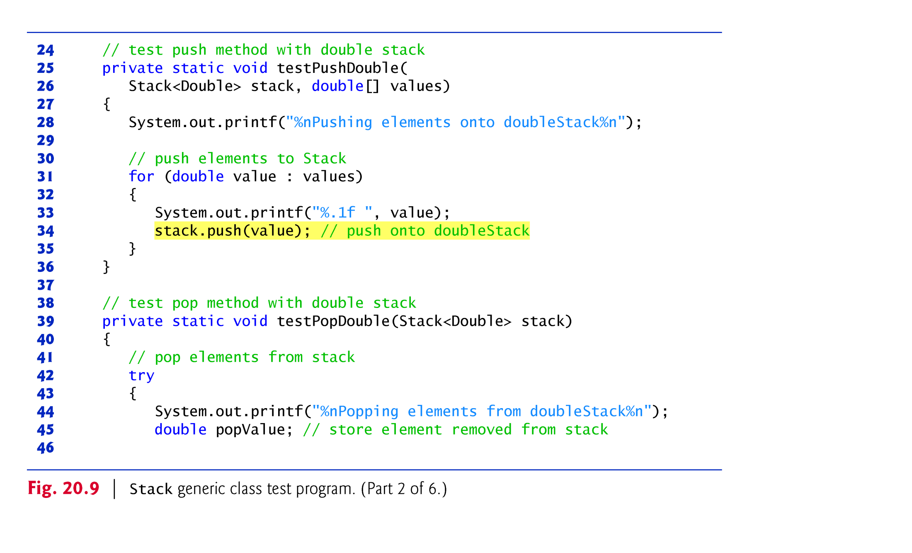
Example 4(C): This program tests the generic stack class in Example 4(A) using non-generic method

Slide 18
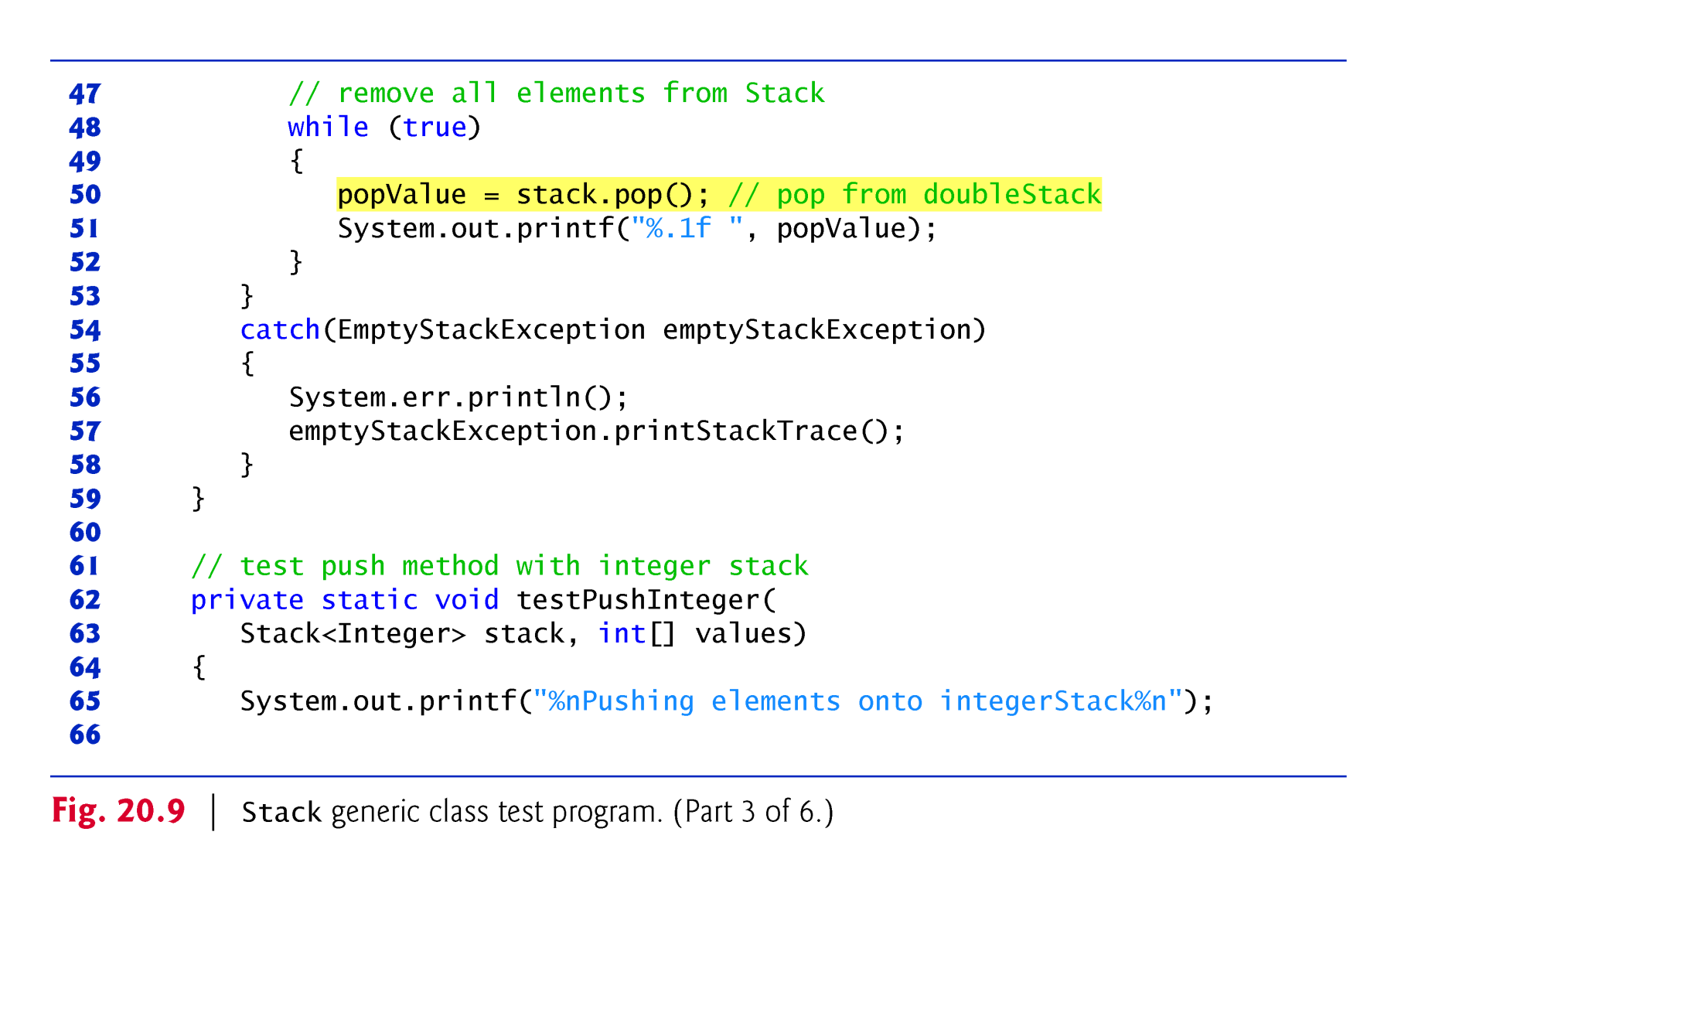
Example 4(C): This program tests the generic stack class in Example 4(A) using non-generic method

Slide 19
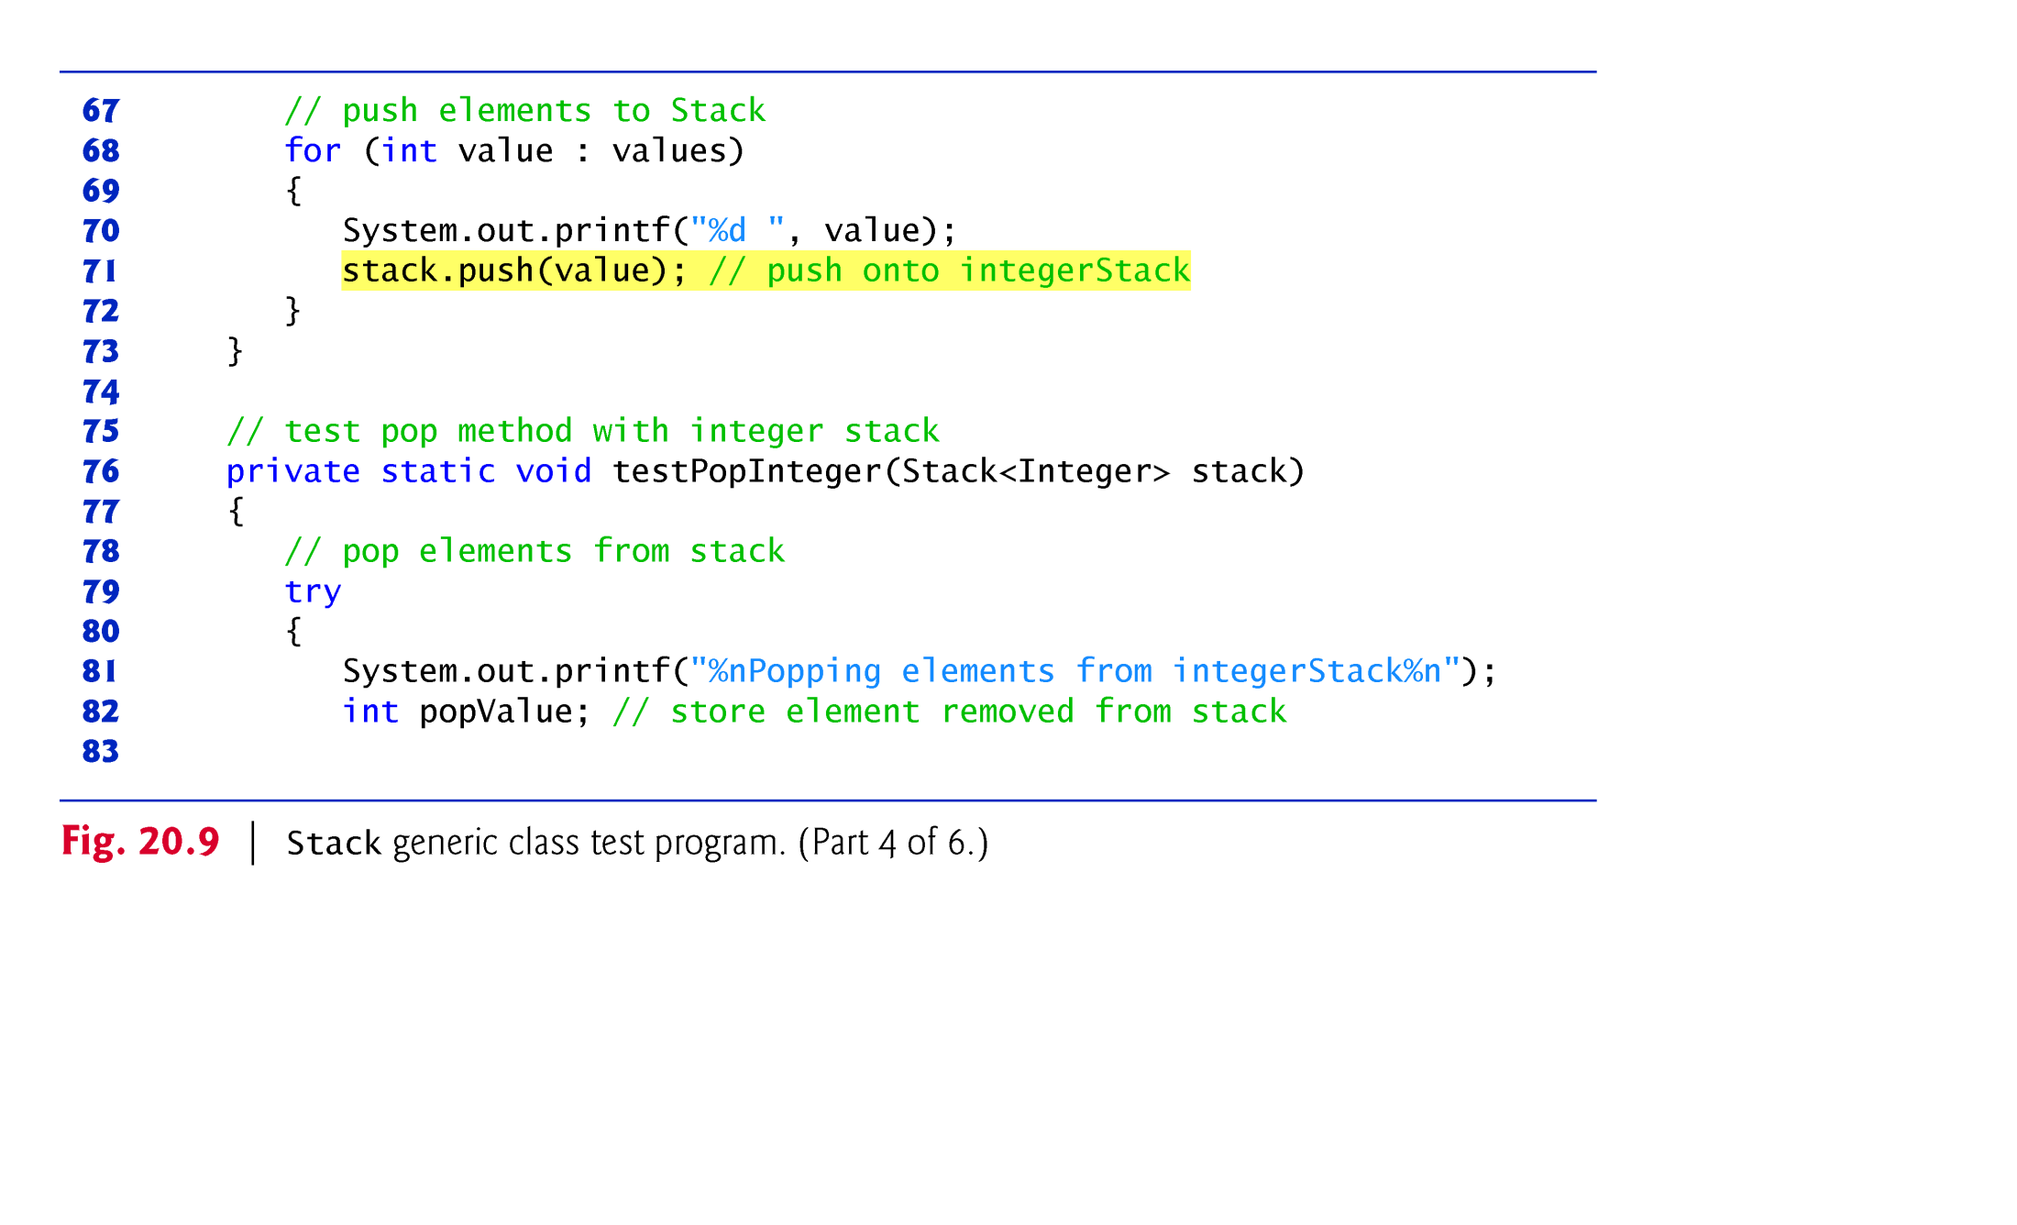
Example 4(C): This program tests the generic stack class in Example 4(A) using non-generic method

Slide 20
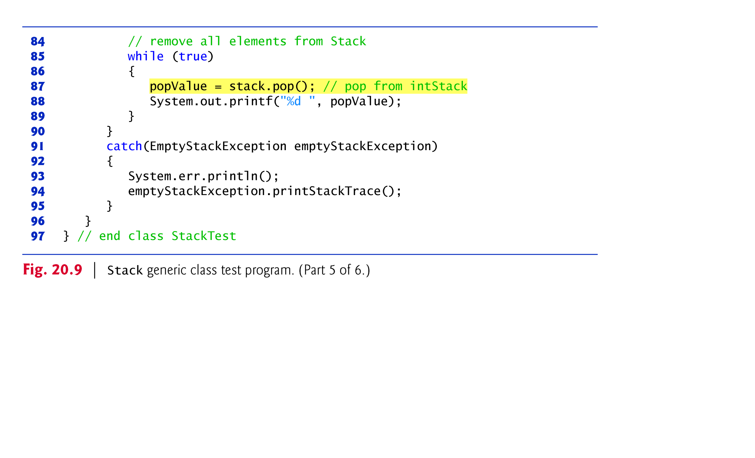
Example 4(C): This program tests the generic stack class in Example 4(A) using non-generic method

Slide 21
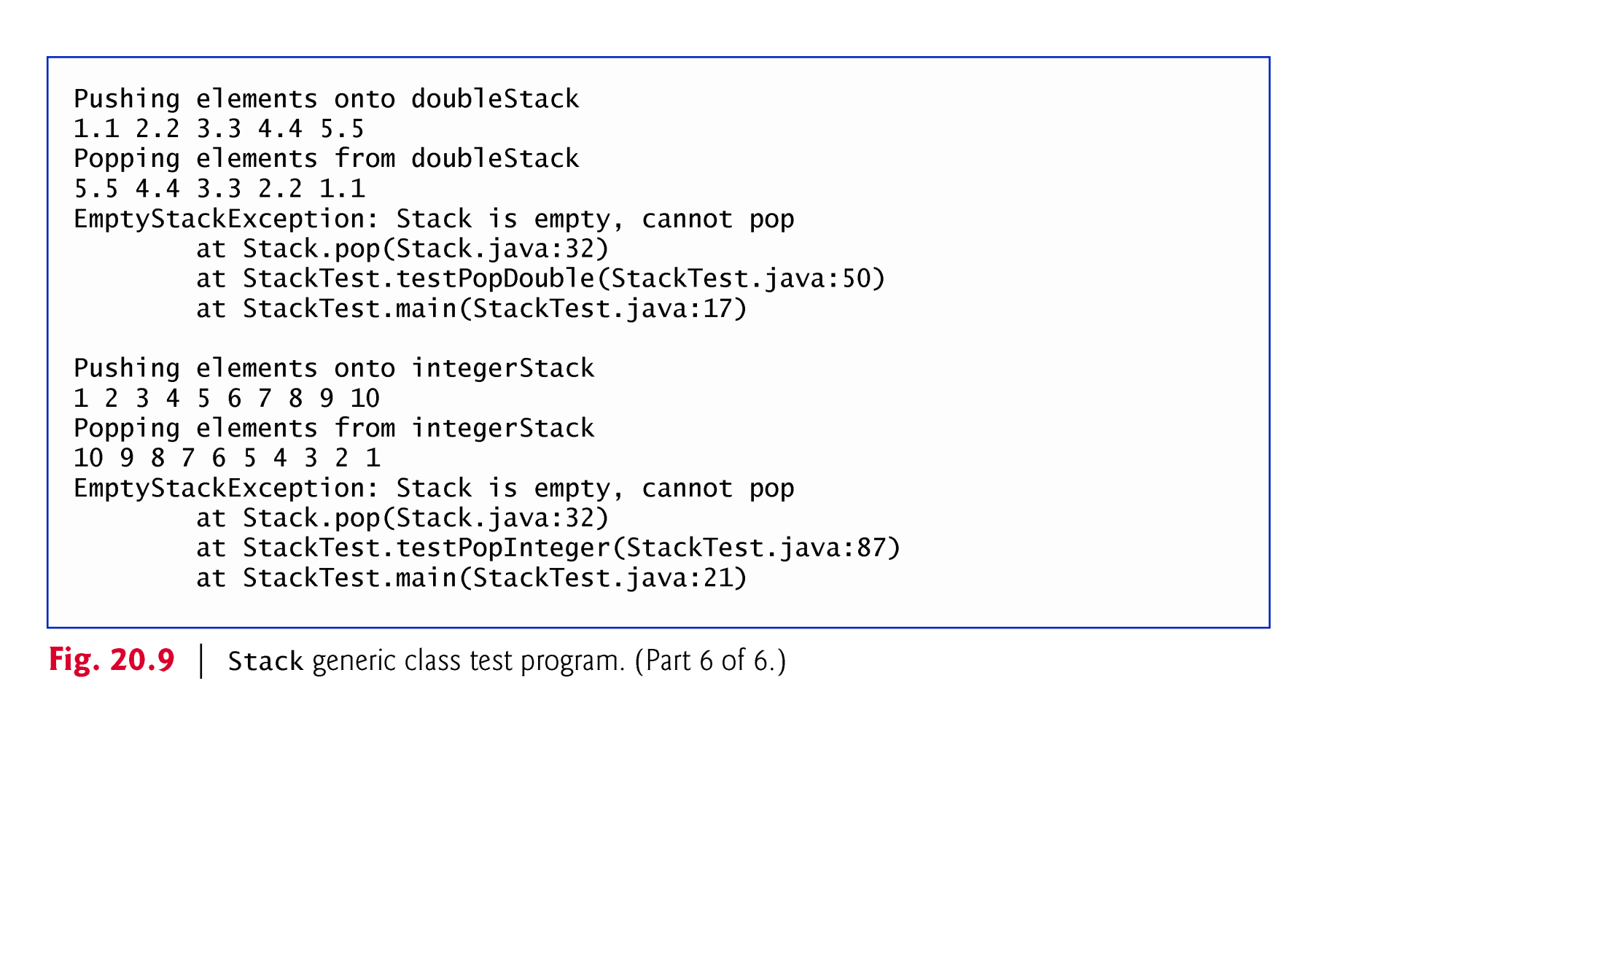
Example 4(D) : This program display the out of The program

Slide 22
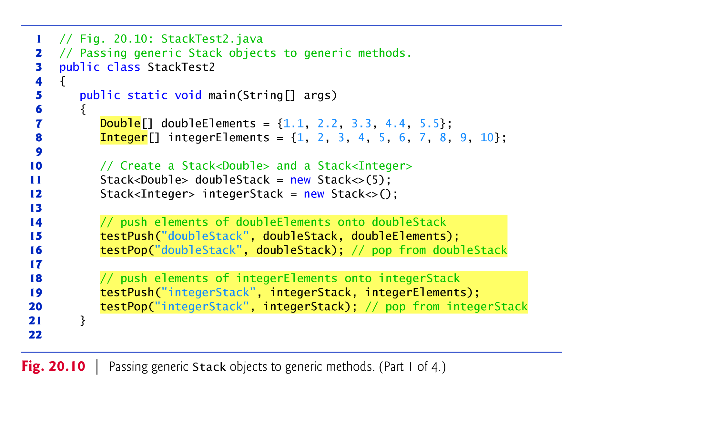
Example 4 (F) : This program tests the generic stack class in Example 4(A) using Generic methods

Slide 23
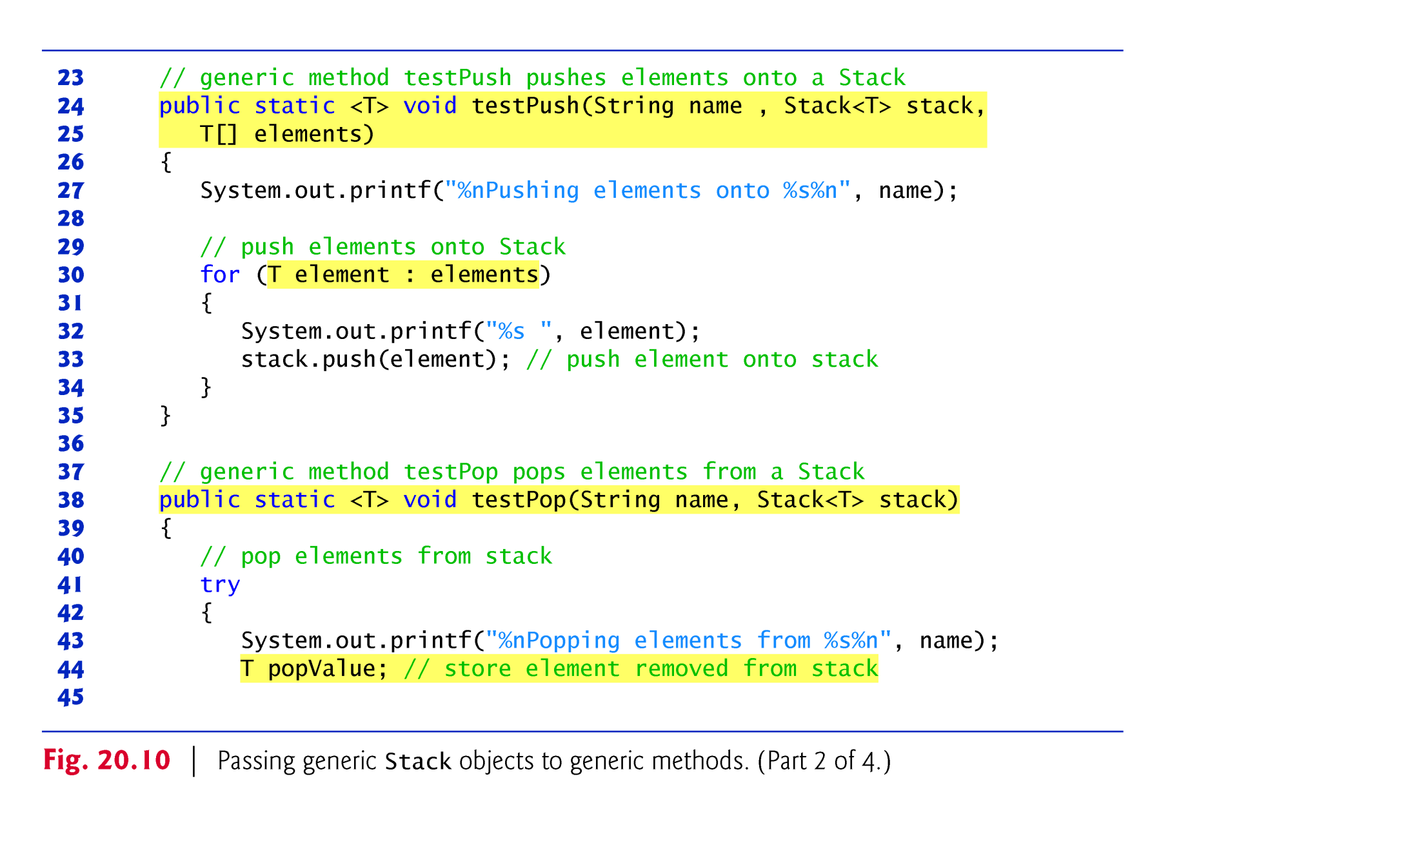
Example 4 (F) : This program tests the generic stack class in Example 4(A) using Generic methods

Slide 24
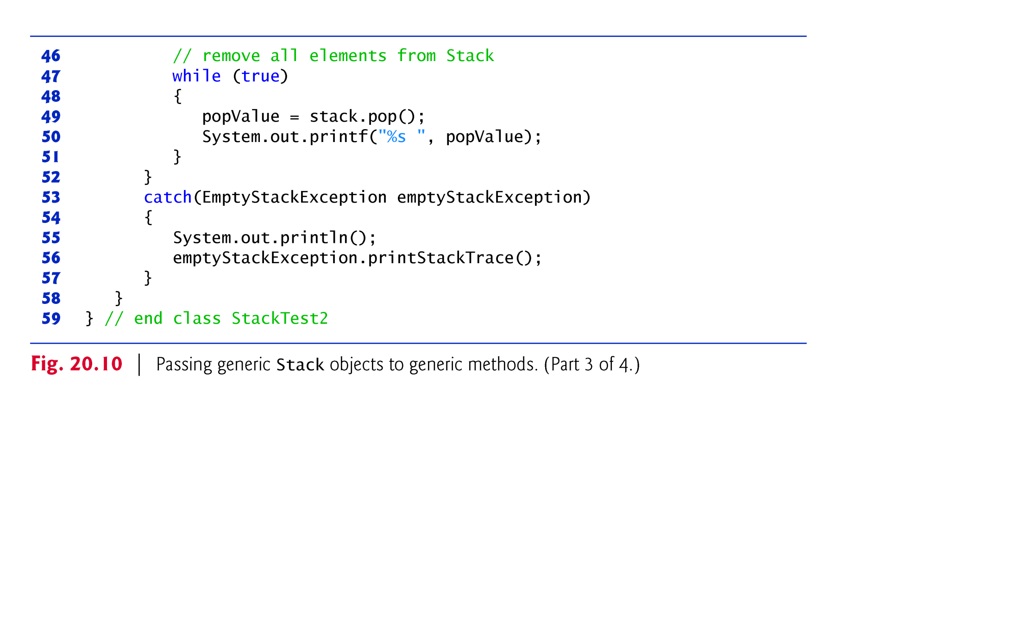
Example 4 (F) : This program tests the generic stack class in Example 4(A) using Generic methods

Slide 25
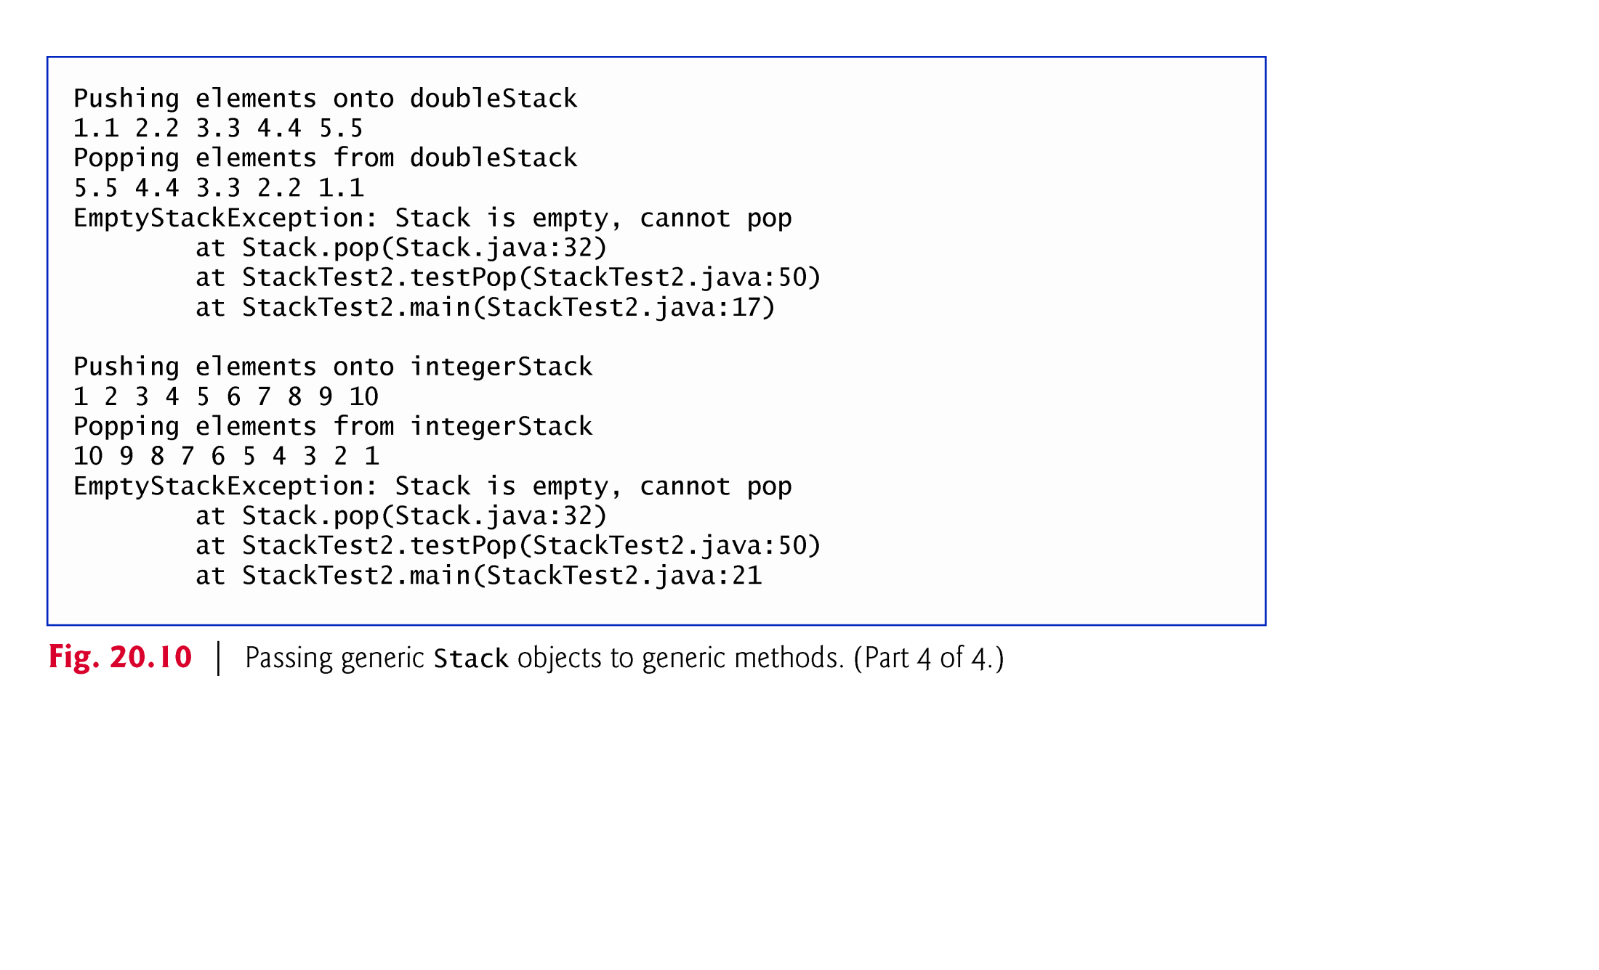
Example 4 (G) : This program display output of Example 4(F)

Slide 26
Raw Type versus type-parameter(T) to create an object of a generic class using constructor
Case 1:Both Left side and right side with raw type
Stack rawTypeStack1 = new Stack(5);
// we can say that rawTypeStack1 is ObjectStack
Since rawTypeStack1 has a raw type, compiler implicitly uses type Object throughout the generic class for each T- type
This statement creates a Stack that can store objects of any type.
This is important for backward compatibility with old versions.
Raw-type operations are unsafe and may cause exceptions.

Slide 27
Raw Type versus type-parameter(T) to create an object of a generic class using constructor
Case 2: Left side with raw type and right side with T-type
Stack rawTypeStack2 = new Stack<Double >(5);
// we can say that rawTypeStack2 is DoubleStack
Since rawTypeStack2 is Object type and Double type is an indirect class of Object type, there is no compiler error
Case 3: Left side with T-type and right side with raw-type
Stack <Integer> IntegerStack = new Stack (5);
This assignment is permitted, but it is not safe because the raw stack on the right side can store types other than Integer type.
Hence, compiler generates warning message to show that the assignment is not safe because programmer should add only Integer type or the type should be compatible to be casted.

Slide 28
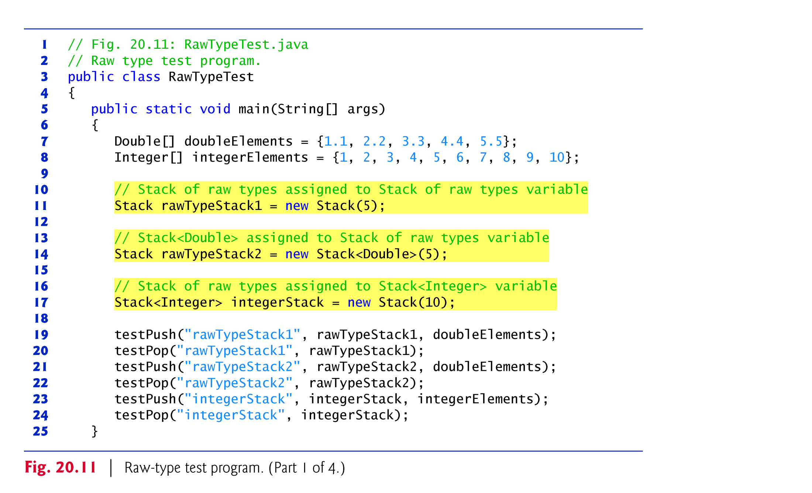
Example 5 (A) : This program illustrates Raw Type and T-type

Slide 29
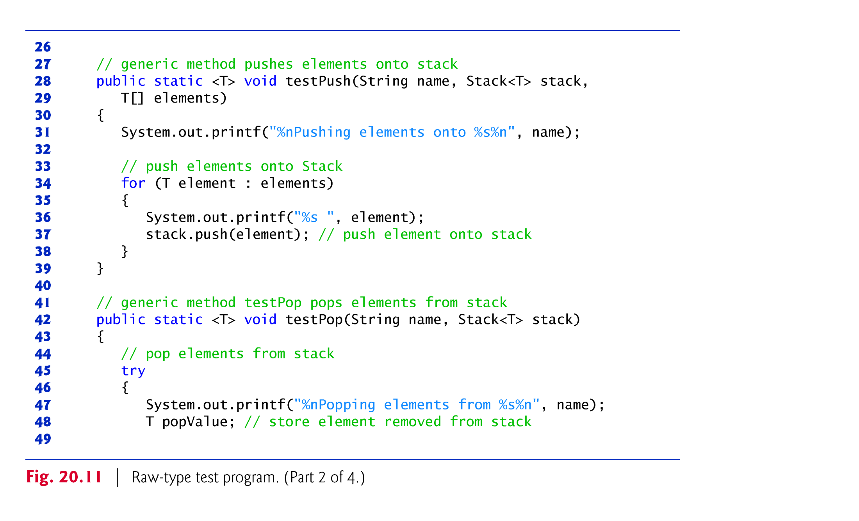
Example 5 (A) : This program illustrates Raw Type and T-type

Slide 30
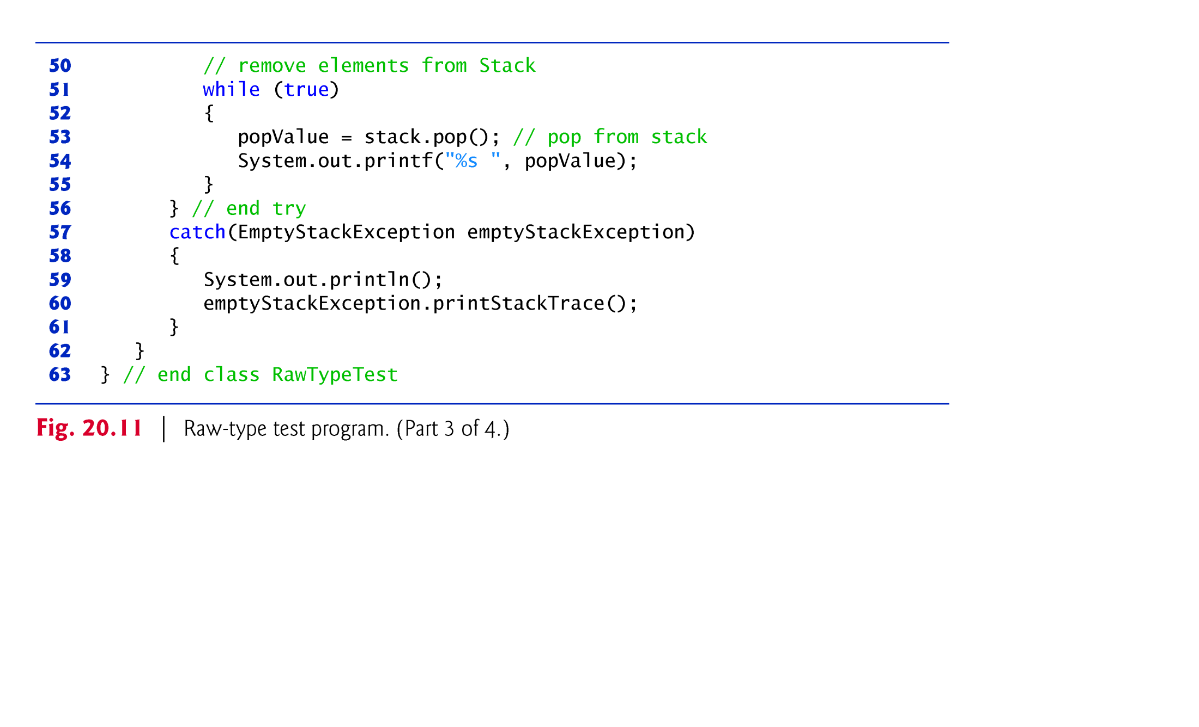
Example 5 (A) : This program illustrates Raw Type and T-type

Slide 31
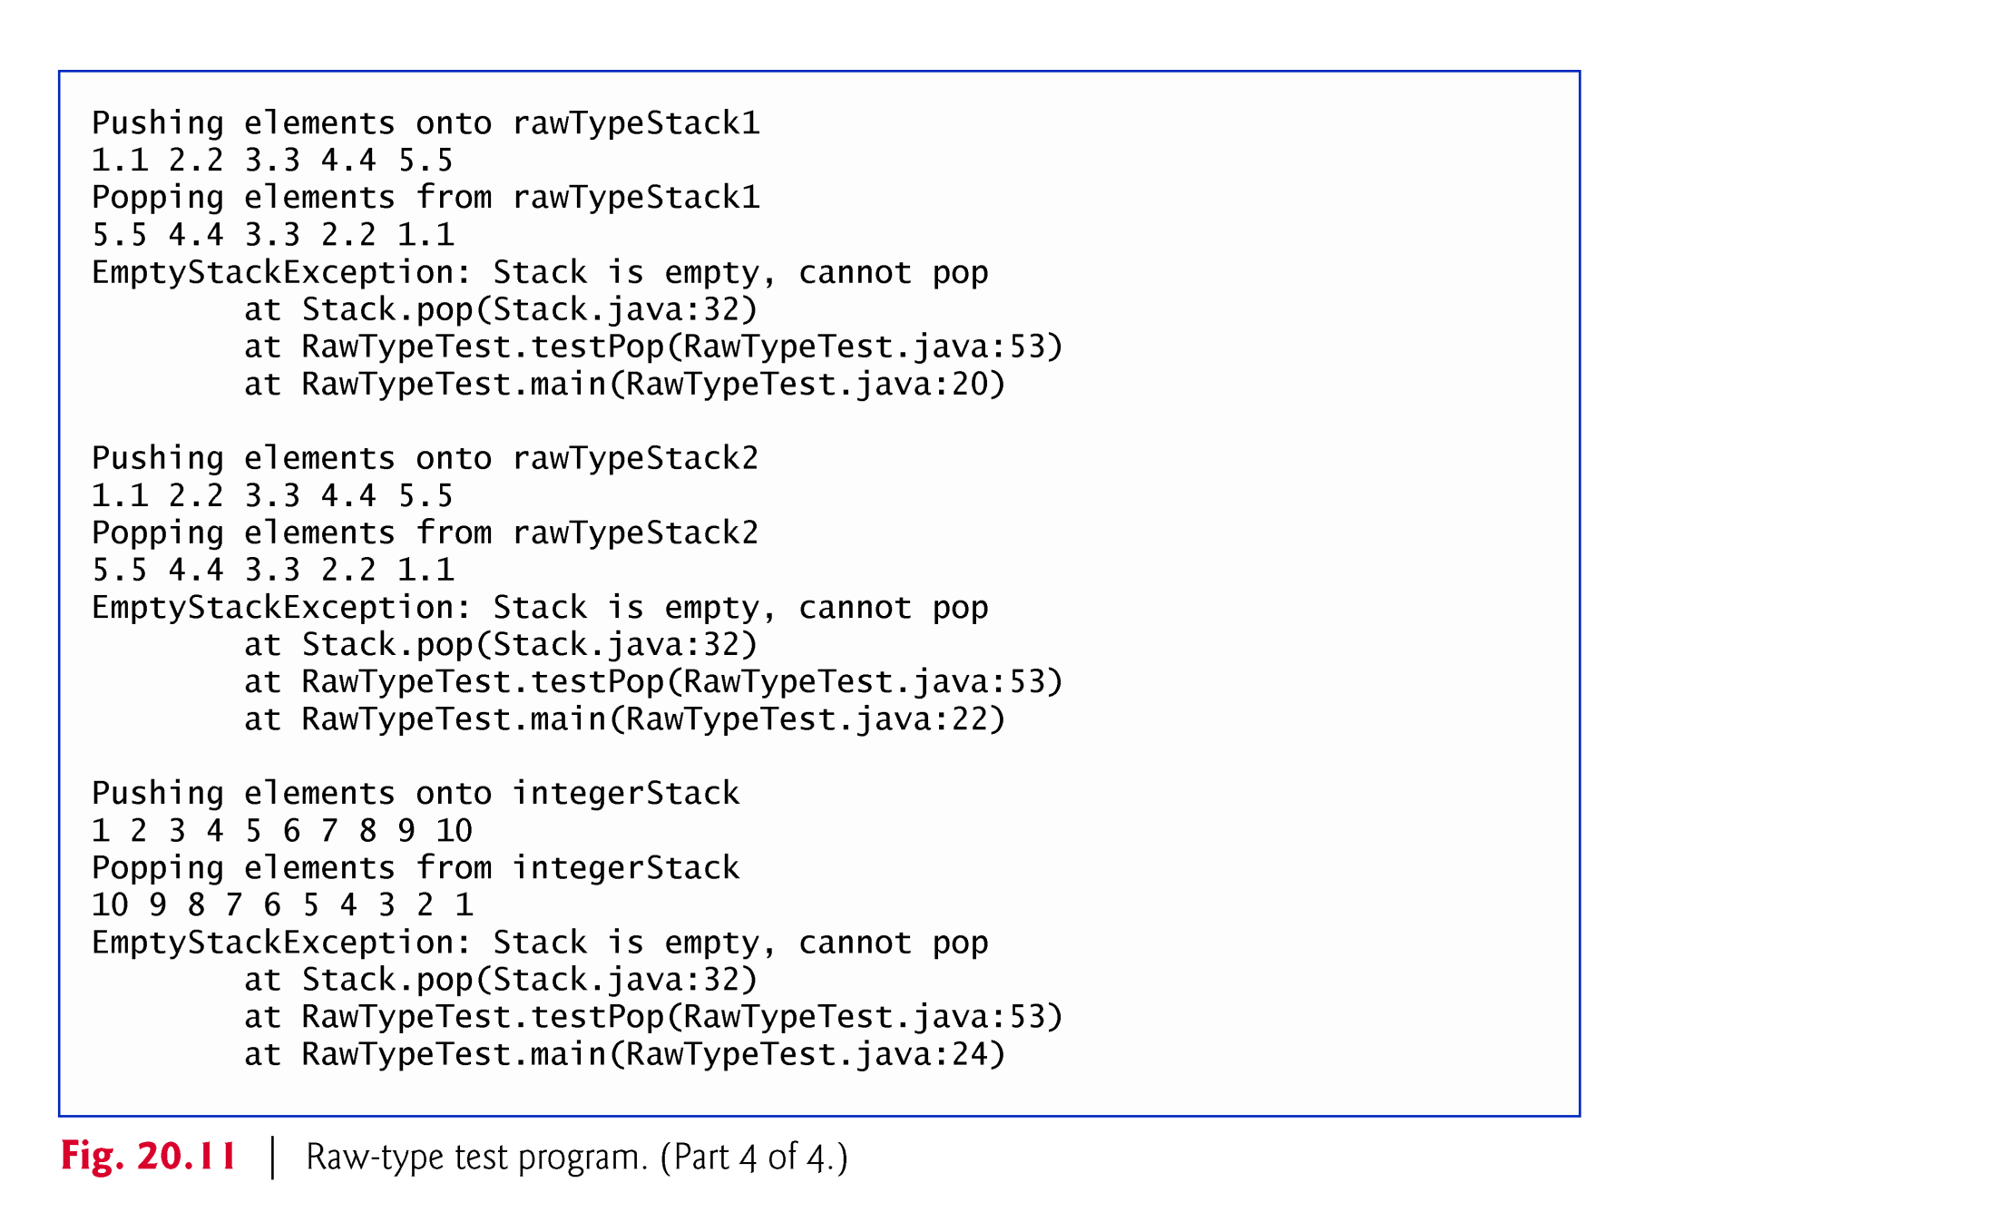
Example 5 (B) : Out put of the program

Slide 32
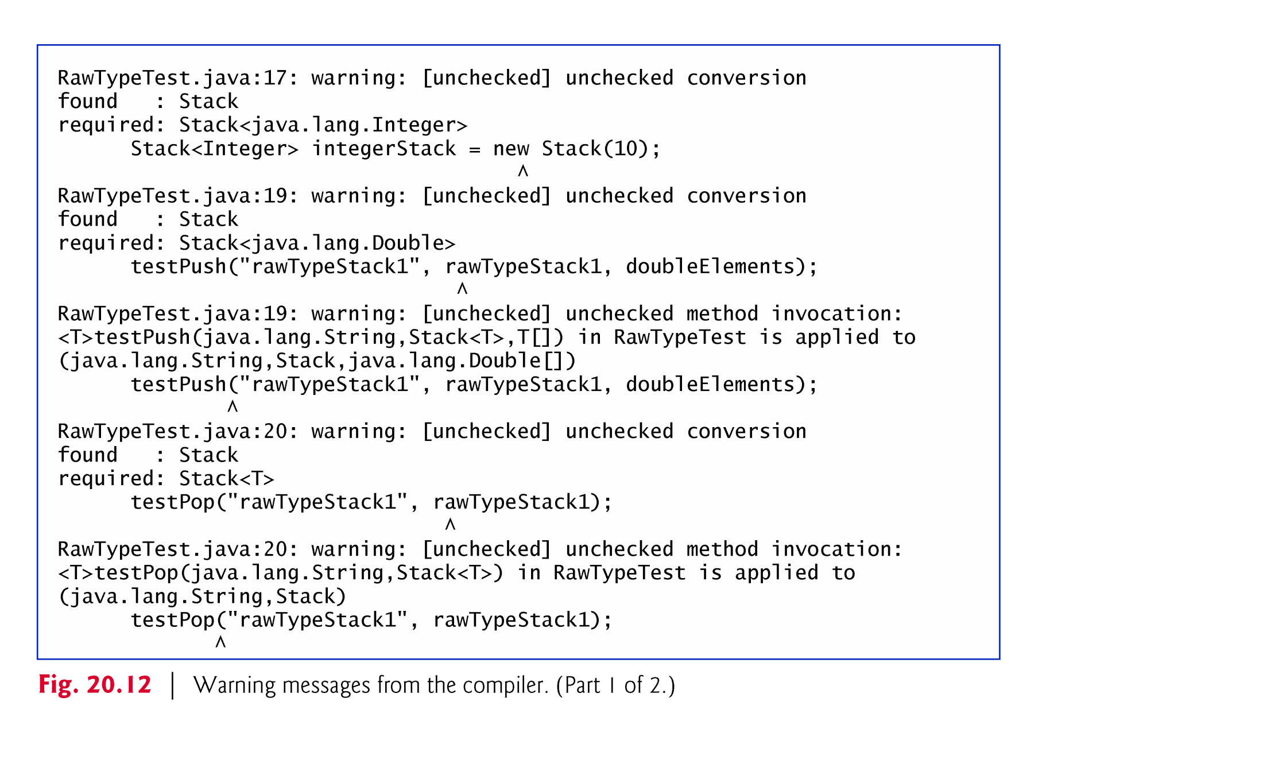
Example 5 (C) : Warning Generated by Compiler
Warning .....cause
1st ………… line 17
2nd ……….... line 19
3rd ……….... line 19
4th ………… line 20
5th ………. …line 19

Slide 33
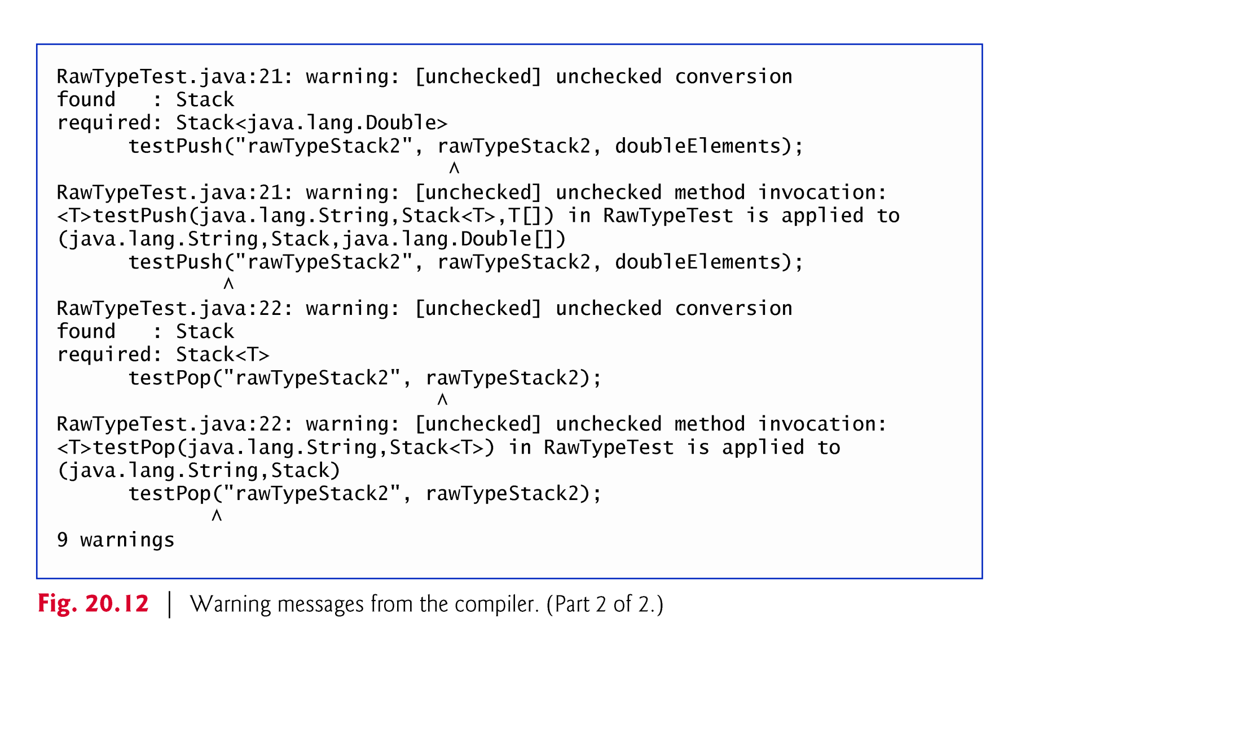
Example 5 (C) : Warning Generated by Compiler
Warning .....cause
6th ………… line 21
7th ……….... line 21
8th ……….... line 22
9th ………… line 22

Slide 34
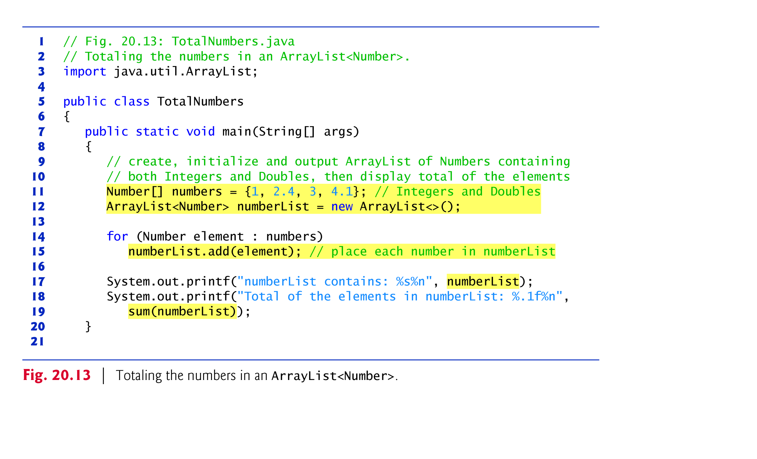
Example 6 (A) : The program to illustrate a method
without using a wildcard- type argument
Object
Number
Integer
Double
Line 11 : Number class is super class of all numeric wrapper classes(polymorphic approach )

Slide 35
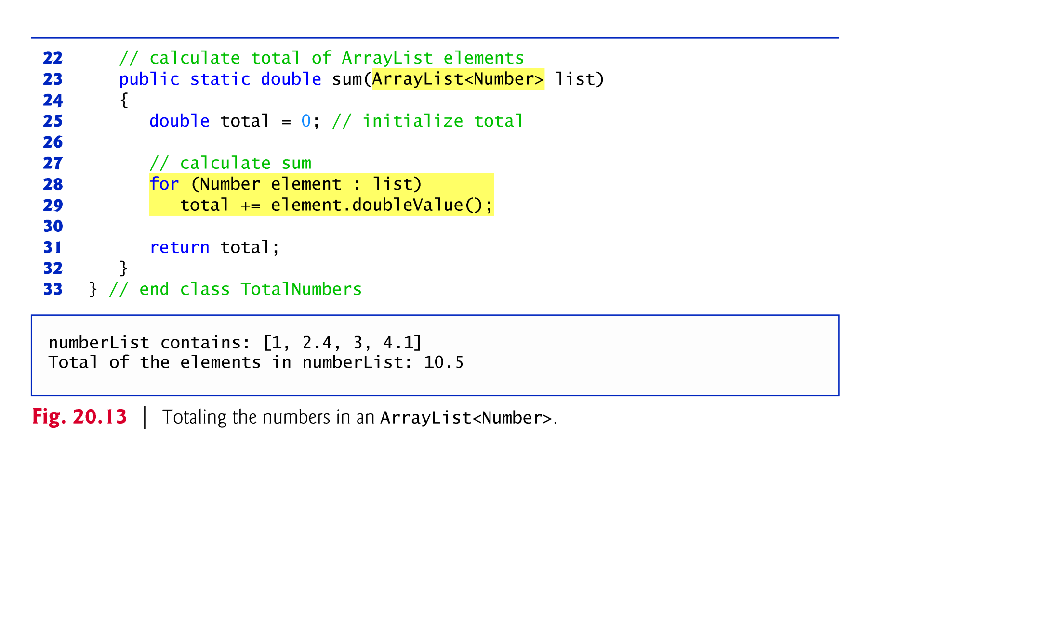
Example 6 (A) : The program to illustrate a method
without using wildcard- type argument cont’d
Line 29 : doubleValue() method belongs to Number class to convert from wrapper type into primitive type
Data type in caller method (line 15 and 19 ) and data type in called method (Line 23) are the same
Hence, Sum() method is not generic method

Slide 36
Example 6 (B) : Modification of Example 6 (A)
Modify the program in example 6(A) by modifying line 11 and 12.
Line 11: Number[] numbers = {1 ,2.4, 3,4.1 }
Line 12: ArrayList <Number > numberList =new ArrayList <>();
Replace line 11 by the following cod
Line 11: Integers[] numbers ={1, 2, 3, 4};
Replace line 12 by the following cod
Line 12: ArrayList <Integer> numberList =new ArrayList <>();
Note: line 23 is not modified
After modification, we get the following compiler error message: sum(ArrayList<Number>) cannot be applied to(ArrayList<Integer>)
The reason is that polymorphism of base-type is allowed, but polymorphism of T-type is not allowed.
In this case, ArrayList is base-type. Number and Integer are T-type
Solution: Modify line 23 by wildcard-type (?) as follows.
ArrayList < ? extends Number>

Slide 37
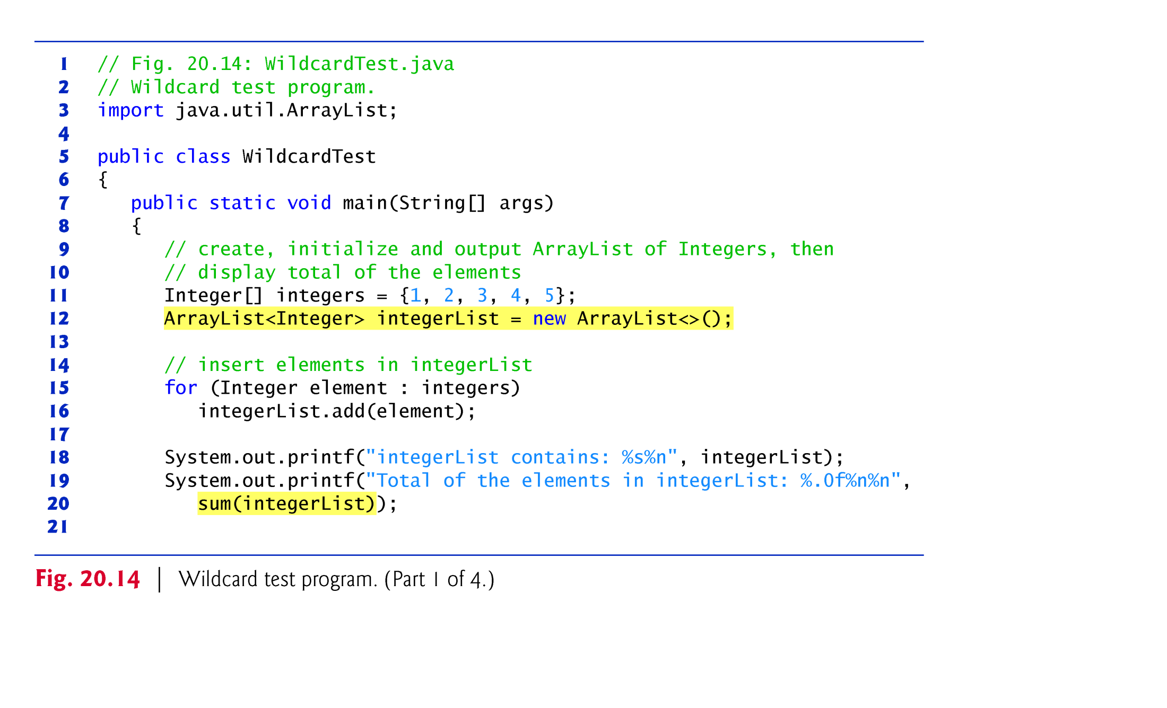
Example 6(c) : Modify Example 6(A) using wildcard- type
as an argument for a method

Slide 38
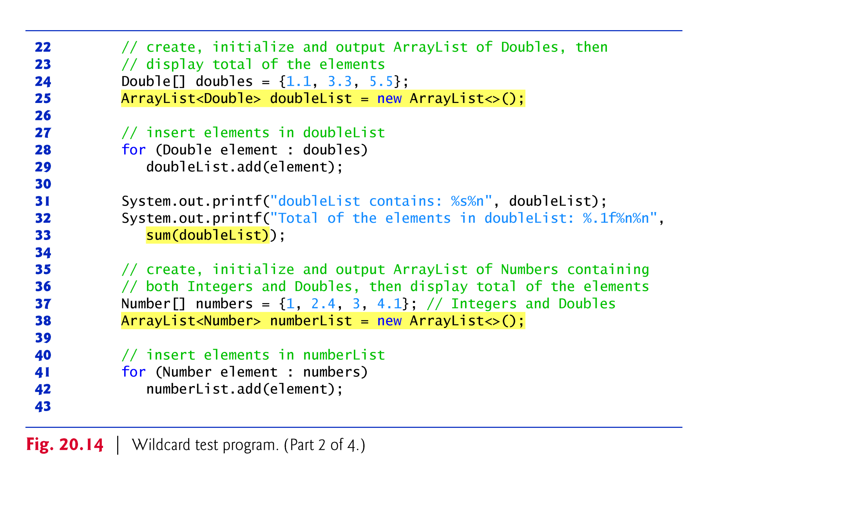
Example 6(c) : Modify Example 6(A) using wildcard- type
as an argument for a method

Slide 39
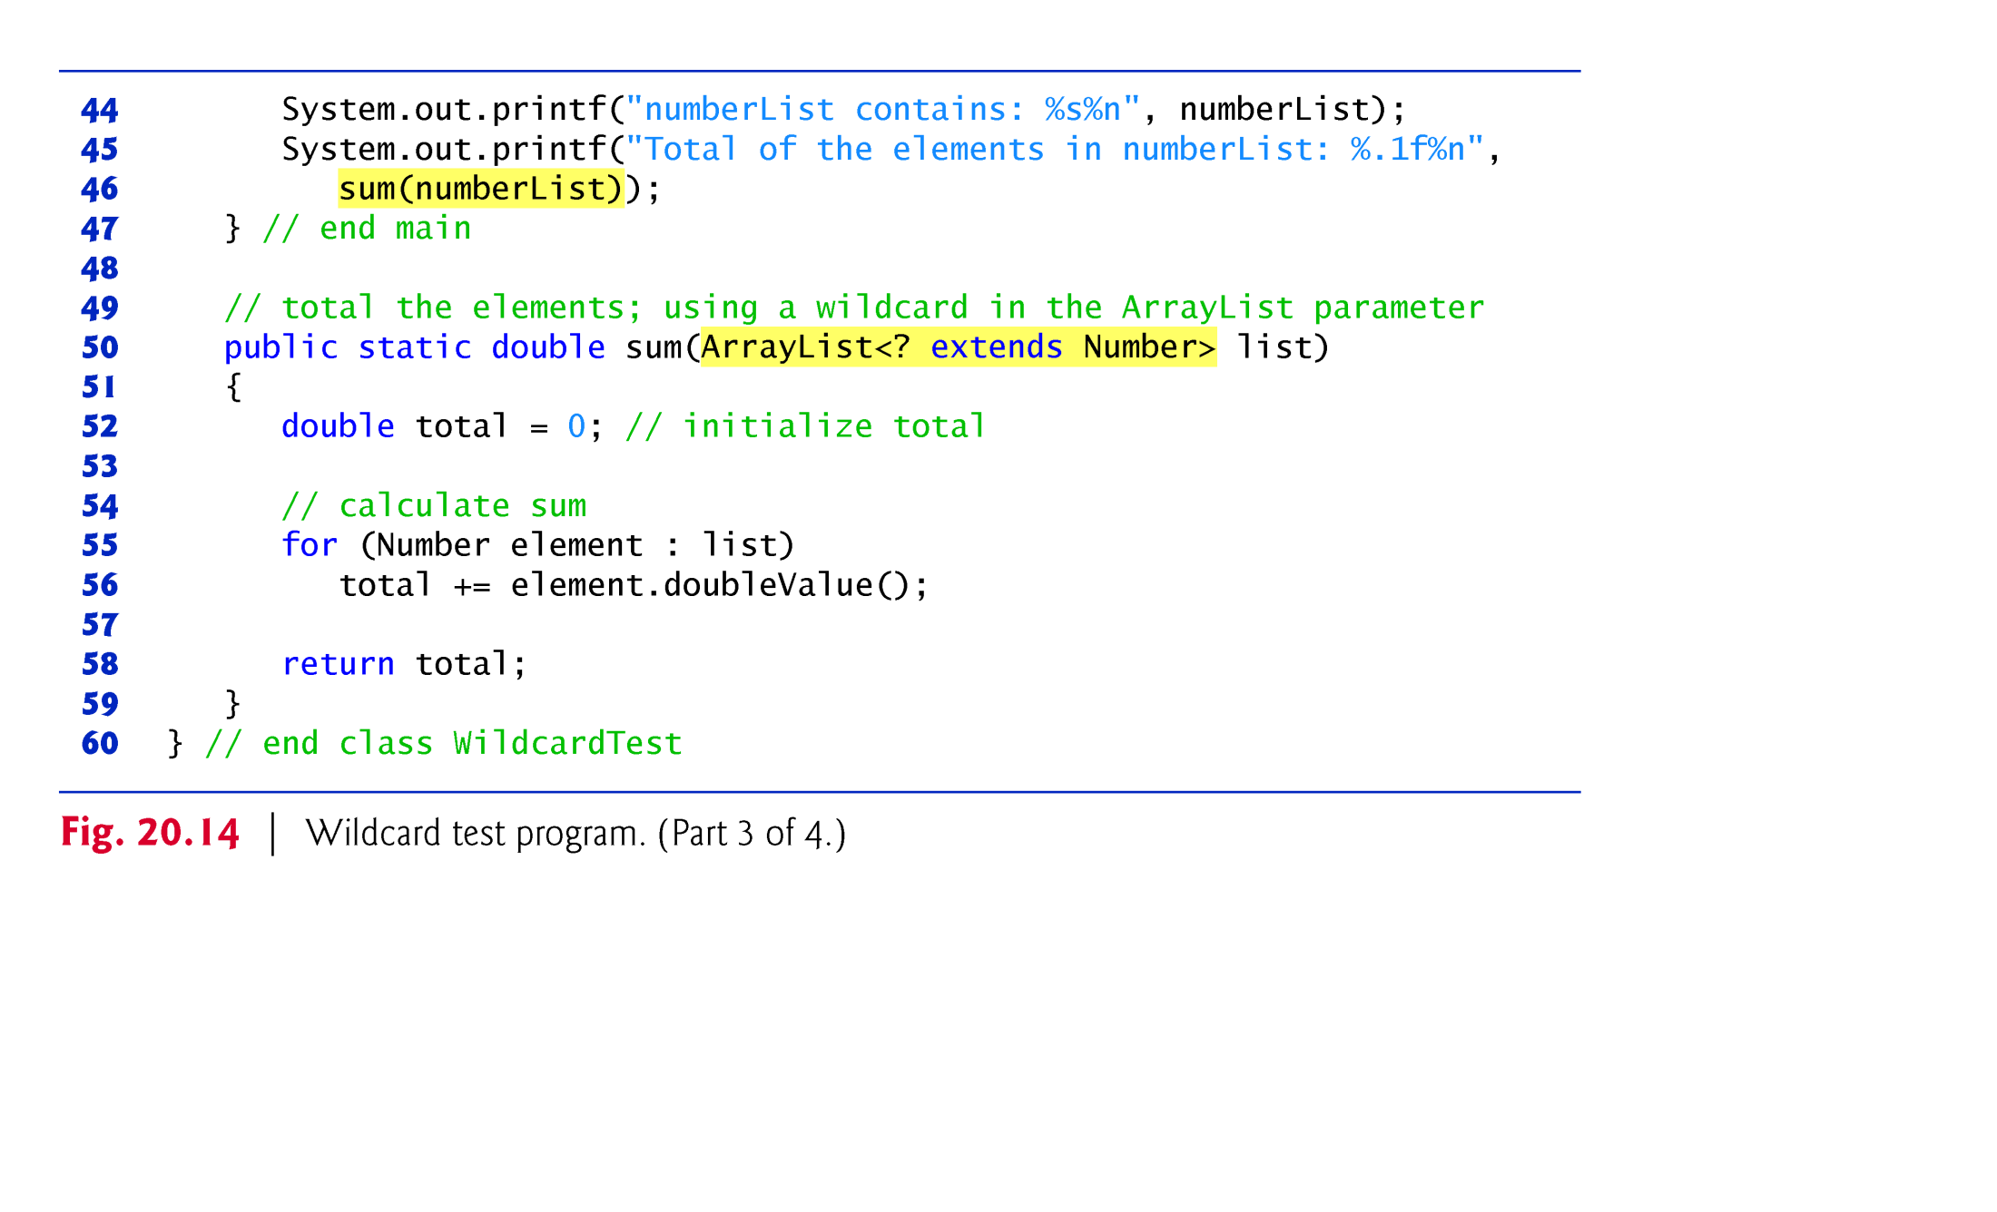
Example 6(c) : Modify Example 6(A) using wildcard- type
as an argument for a method
Data type in caller method (line 20, 33 and 46 ) and data type in called method (Line 50 ) are different
Hence, sum() method is generic method

Slide 40
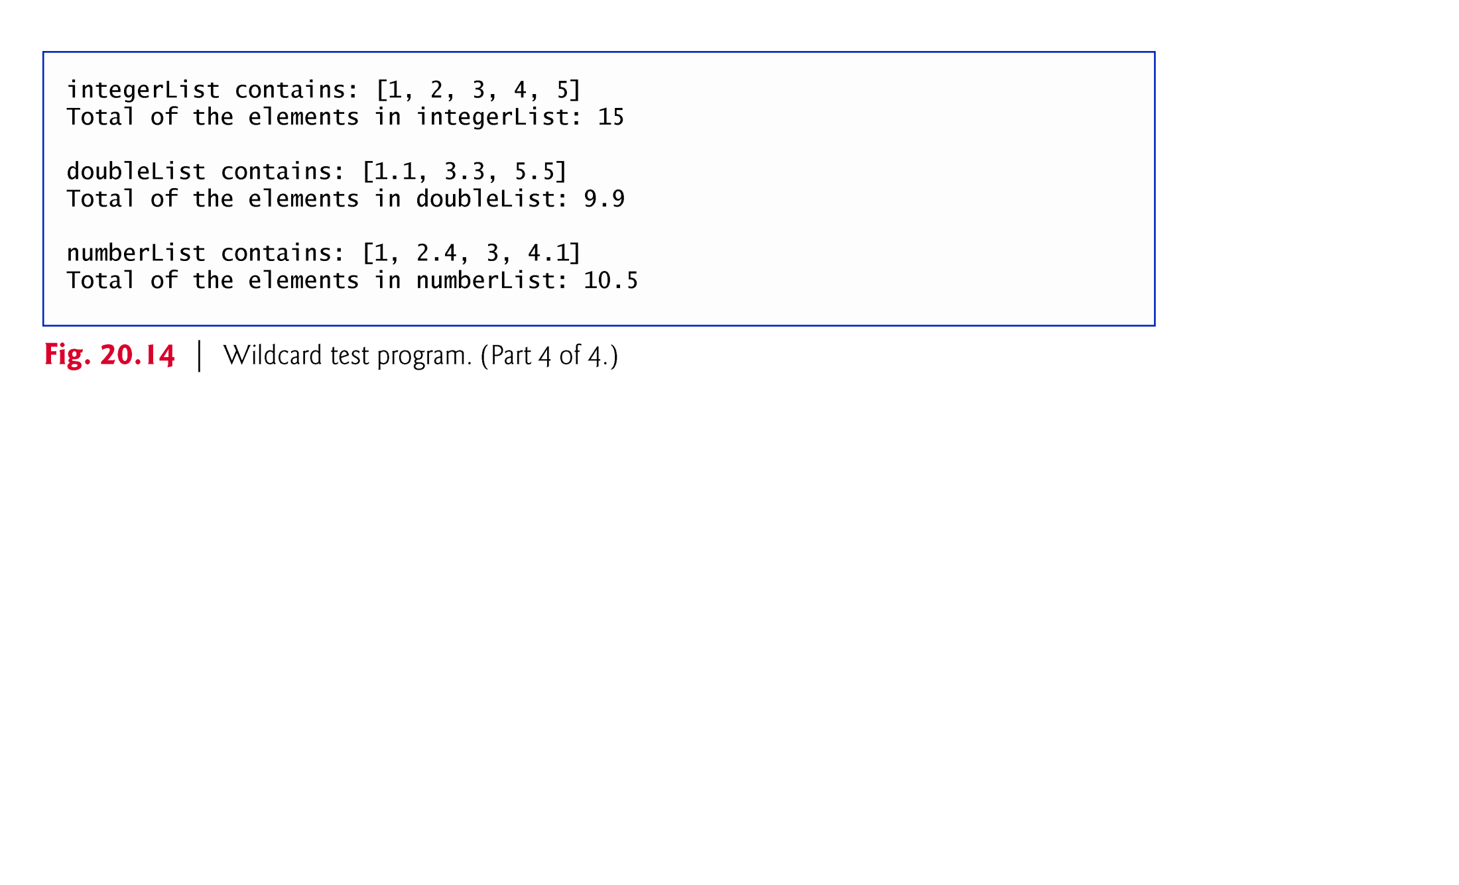
Example 6 (C) : The output of the program after modification of Example 6 (A)

Slide 41
Notes about wildcard-type argument of a method
The wildcard (?) in the method’s argument cannot be used a type name in the method’s body
In Example 6(c), we cannot replace “Number”( line 55) by ? (wildcard type)
Solution: In Example 6(c), declare sum() at line 50 as follows :
public static <T extends Number> double sum( ArrayList< T > list )
allows the method to receive an ArrayList that contains elements of any Number subclass.
We can also use T in the body of sum () method .
If the wildcard-Type has no upper bound type , then only the methods of type Object can be invoked on values of the wildcard type.
Methods that use wildcard-type in their arguments cannot be used to add elements to a collection referenced by the parameter.

